Slide 1

Tell Me What You Feel
Lebanese University
Faculty of Information, Branch II
Presented By :
Ismail Khodr Kattar
Romy Bou Abdo
Supervised By :
Mr. Elie Dina
Dr. Kassem Rammal
Notes:
"Good [morning/afternoon/evening], everyone. Welcome to our presentation titled 'Tell Me What You Feel.' My name is Ismail Khodr Kattar, and alongside my colleague Romy Bou Abdo, we have worked under the guidance of Mr. Elie Dina and Dr. Kassem Rammal to bring you this study."

Slide 2



Introduction
She is___?
He is ____?
Notes:
Let's start with a simple question. Can you tell what is their feelings after hearing the audio

Slide 3



Introduction
She is sad
He is angry
Notes:
Let's start with a simple question. Can you tell what is their feelings after hearing the audio

Slide 4

Introduction
Do Computers and Robots understand our emotions and feelings ?
How can they?
Notes:
Our research delves into this intriguing question. We aim to explore whether machines can accurately interpret human emotions through speech patterns and vocal tones

Slide 5

Introduction
SER or Speech Emotion Recognition is the process of making computers able to understand emotions
Why SER?
Active research area
Aiming to improve the user experience
Notes:
WHat is SER ? “"Speech Emotion Recognition, or SER, is the process of enabling computers to understand human emotions through speech
Why SER
apidly growing field because of its potential benefits. It aims to enhance user experiences and provide support for those who find it challenging to understand emotions, making technology more inclusive

Slide 6
Methodology
2 different approaches:
Approach 1: Utilize different Machine Learning Models.
Approach 2: Utilize CNN in Deep Learning.
Goal: achieve higher accuracy and develop more generalizable model for SER
Comparison of those 2 approaches
Notes:
"Our study explores two approaches to speech emotion recognition: the use of various machine learning models and the application of Convolutional Neural Networks (CNN) in deep learning. Our goal is to achieve higher accuracy and create more generalizable model
now my colleague will introduce you to the data we used ,data we worked with Ravdess data set

Slide 7
Data
RAVDESS data set :
1440 audio files: wav format
Modality: 01: full-AV - 02: video-only - 03: audio-only
Vocal Number: 01: speech - 02: song
Emotion: 01: Neutral - 02: calm - 03: happy - 04: sad - 05: angry -
06: fearful - 07: disgust - 08: surprised
Intensity: 01: Normal - 02: Strong
Statement: 01: "Children are talking by the door" - 02: "Dogs are
sitting by the door"
Repetition: 01: 1st repetition - 02: 2nd repetition
Actor: 01 to 24 - male: odd numbers - female: even numbers
e.g. 03-01-05-01-0 1-02-12.wav
Notes:
In this study, we used the RAVDESS dataset containing 1440 audios as wav format from which we took audio only as modality and speech as vocal number.
It contains 8 emotions: neutral, calm, happy, sad, angry, fearful, disgust and surprised where each emotion is represented by a number, 2 intensities normal and strong, 2 statements, 2 repetitions and 24 actors where male are presented with odd numbers and females with even number.
For example this file is audio only - speech - angry - normal - 1st statement - 2nd repetition - actor 12 (female)

Slide 8
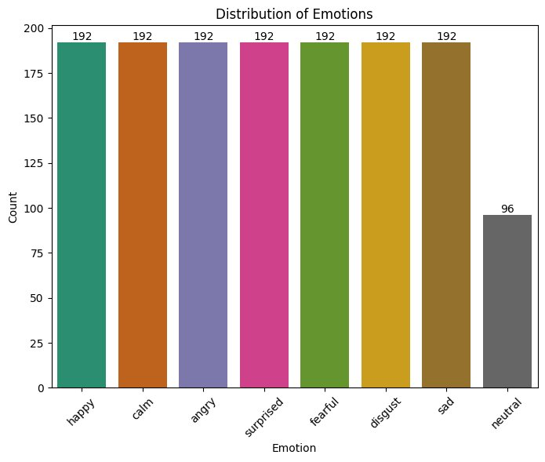
Exploratory Data Analysis (EDA) - Distribution Of Emotions
Notes:
Here is represented the distribution of emotions.
We can see that neutral is 96 which is half of all the other emotions (192) because neutral doesn’t contain any strong intensity.

Slide 9
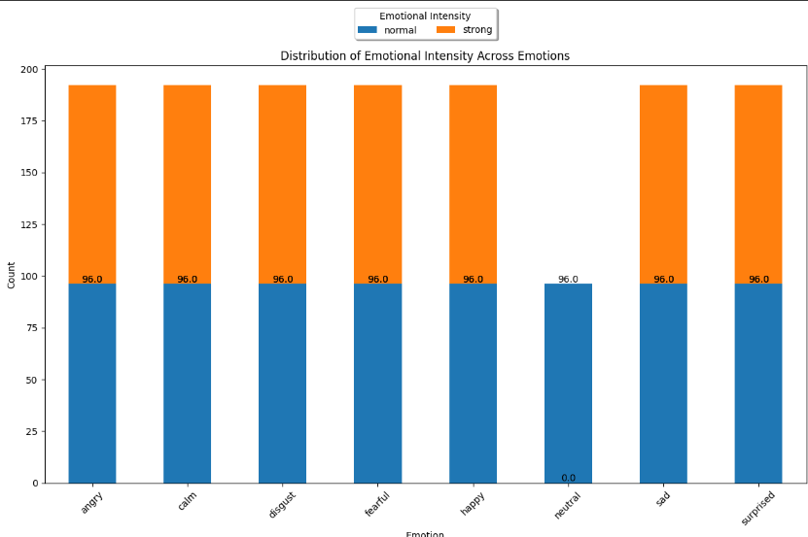
EDA- Distribution Of Emotional Intensity Across Emotions
Notes:
In this graph it’s shown more clearly the distribution of emotions regarding to intensity where we can see that intensities are equally distributed between each emotion.

Slide 10
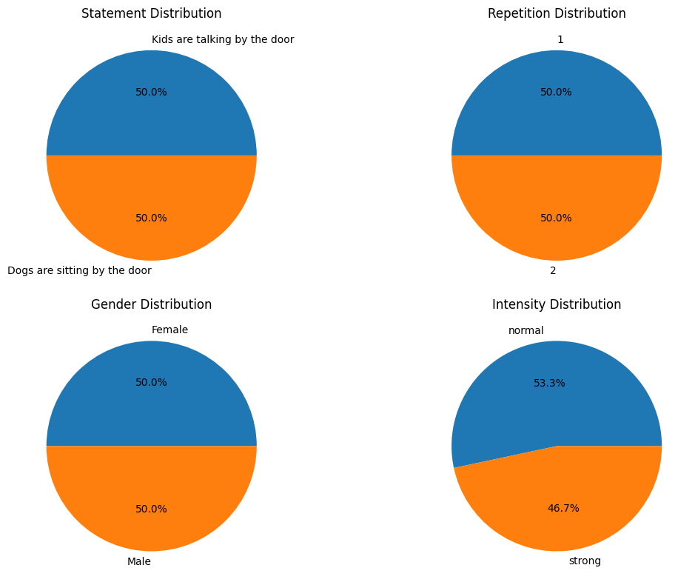
EDA - Statement - Repetition - Gender - Intensity Distribution
Notes:
Those pie plots show how statements, repetitions and gender are equally distributed. Normal intensity presents a bigger part because as mentioned neutral doesn’t contain any strong intensity.

Slide 11
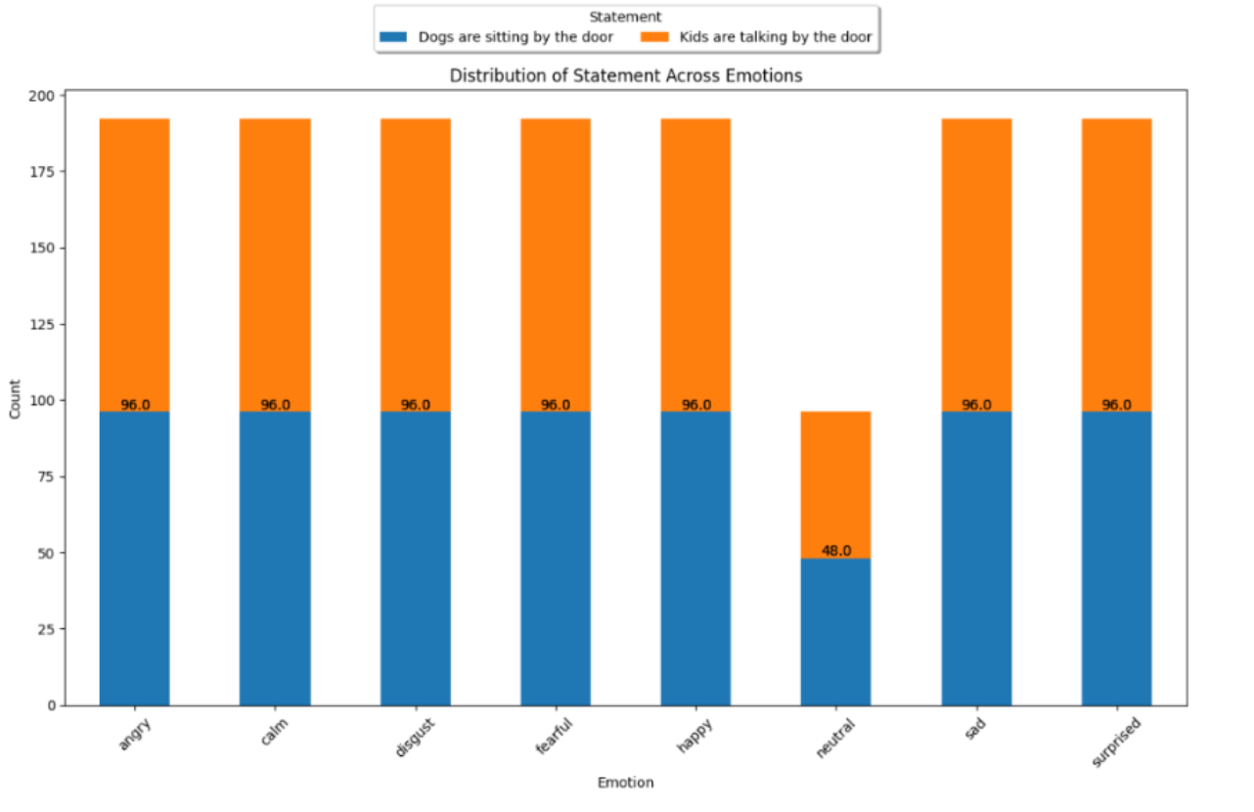
EDA - Distribution Of Statement Across Emotions
Notes:
For here we can see the statements are equally distributed between each emotion which means half of the statements for each emotion represents the first and the other half represents the second statement.

Slide 12
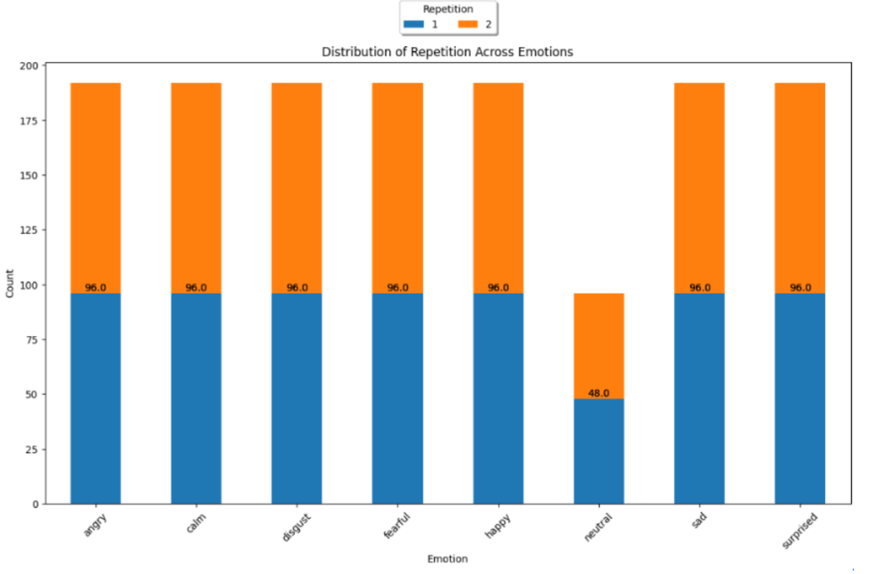
EDA - Distribution Of Repetition Across Emotions
Notes:
Same for here, repetitions are equally distributed between the emotions.

Slide 13
EDA – Audio
Description
Count | 1440.00
Mean | 3.70
STD | 0.34
Min | 2.94
25% | 3.47
50% | 3.67
75% | 3.87
Max | 5.27
Notes:
The statistics for audio length were calculated and we can see that the shortest audio length is of 2.94 sec, maximum length 5.27sec and most of the audios ranges between 3.47 and 3.87 sec.
The majority of the audio files are around 3.70 seconds long, as indicated by the mean and median values being quite close (3.70 and 3.67 seconds, respectively).
The standard deviation of 0.34 seconds is relatively small compared to the mean, suggesting that most audio files have durations close to the average duration.

Slide 14
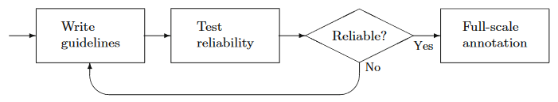
IAA - Inter
Annotator Agreement
IAA evaluates the consistency with which several annotators can annotate a given label category or class.
9 heatmaps were done for IAA calculation:
Emotion comparison
Emotional intensity comparison
Emotion and Intensity comparison
Notes:
Inter-annotator agreement is a measure of how consistently different people (annotators) label or classify data. It ensures reliability.
There is no "ground truth" regarding the manual annotation, since it is based on people’s judgment.
But instead, the reliability of the annotation is measured (if the annotators agree on the annotations).
To ensure reliability, each item is annotated by 2 different annotators (me and Ismail), which will be compared amongst each other and the Gold Data (assigned annotation)
In this case 9 heatmpas are conducted, 3 for emotion comparison, 3 for emotion and intensity and 3 for intensity.
For instance, we have for the emotion comparison one heatmap between my annotation and gold’s annotations, one between ismail’s annotation and the gold annotation and the third one between my annotation and ismail’s annotation.
NOTES
Inter-annotator agreement is a measure of how consistently different people (annotators) label or classify data. It indicates the level of agreement or reliability among multiple annotators when they independently assign labels or make decisions about the same set of items. High inter-annotator agreement means the annotators are consistent in their labeling, suggesting the task is clear and the criteria are well-defined.
IAA evaluates the consistency with which several annotators can annotate a given label category or class. It also perceives the quality of the annotation of a corpus.
Ensures Quality: High inter-annotator agreement indicates reliable and consistent labeling, which is crucial for training accurate machine learning models.
Identifies Ambiguities: Highlights areas where the annotation guidelines may be unclear or subjective, allowing for refinement and improvement.
Increases Trust: Enhances confidence in the annotated dataset, making it more trustworthy for subsequent analysis and model training
IAA evaluates the consistency with which several annotators can annotate a given label category or class. It also perceives the quality of the annotation of a corpus. In linguistic matters, correctness cannot be measured. There is no "ground truth" regarding the manual annotation, since it is based on people’s judgment. But instead, the reliability of the annotation is measured (if the annotators agree on the annotations). To ensure reliability, each item is annotated by 2 different annotators (Annotator 1 and Annotator 2), which will be compared amongst each other and the Gold Data (assigned annotation) as reliability ensures correctness. Some agreements may be accidental. To eliminate this factor, IAA calculations will be conducted to determine the "proportion" of agreement above chance. The S coefficient, π coefficient, and κ coefficient are metrics that will be calculated (showing immediately the results) and defined below. 126 audios were randomly chosen and annotated regarding the 8 emotions (Neutral, Calm, Happy, Sad, Angry, Fearful, Disgust, and Surprised), 2 emotional intensities (normal, strong), and their combination of 15 tags which will represent 9(=3x3) heat maps shown in Figure 4.1.

Slide 15
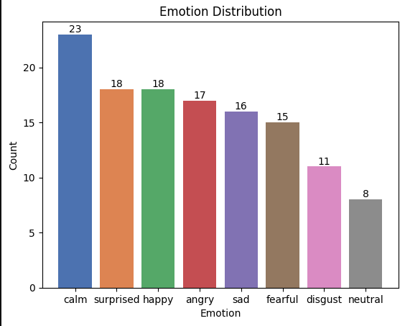
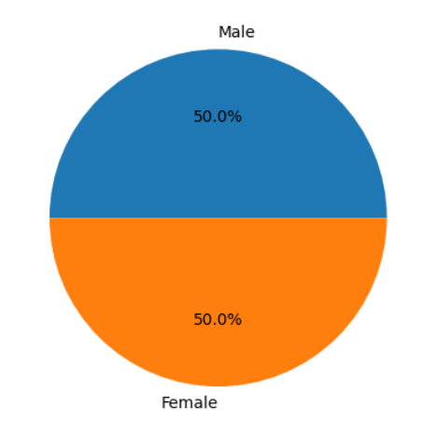
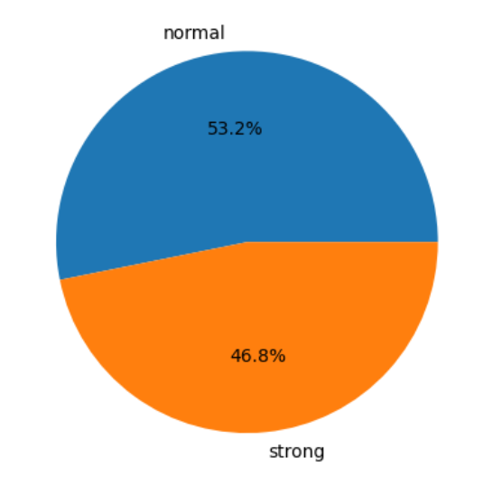
IAA - Guidelines
126 audios
Gender equally distributed
κ metric
Notes:
126 audios were randomly chosen and annotated regarding the 8 emotions and 2 intensities
Genders are equally distributed
Intensities are almost equally distributed bcs neutral…
and motion distribution is represented in this graph
we are going to evaluate based on n the kappa metric

Slide 16
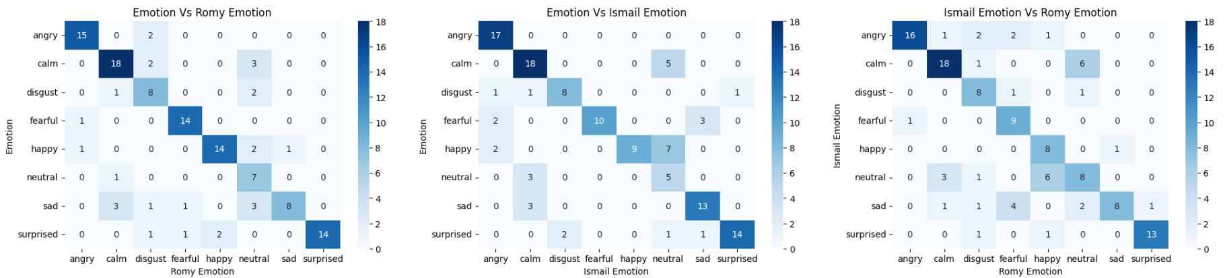
IAA - Emotion Heatmaps
κ=74.51%
κ=70.82%
κ=65.33%
Notes:
Here are the 3 emotion heatmaps, for example between my annotations and the actual annotations i was able to distinguish best angry and fearful

Slide 17
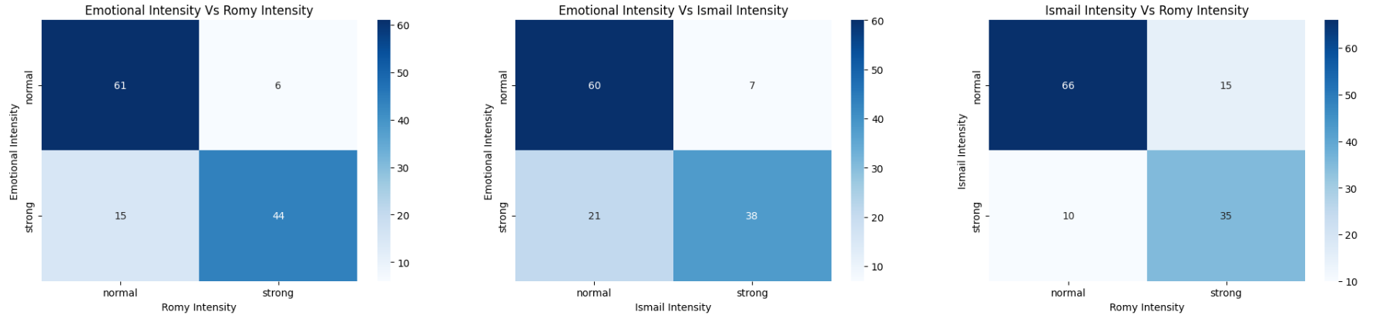
IAA - Emotional Intensity Heatmaps
κ=66.22%
κ=54.73%
κ=57.83%
Notes:
For the intensity comparison, Ismail perceived more normal intensities than strong ones.

Slide 18
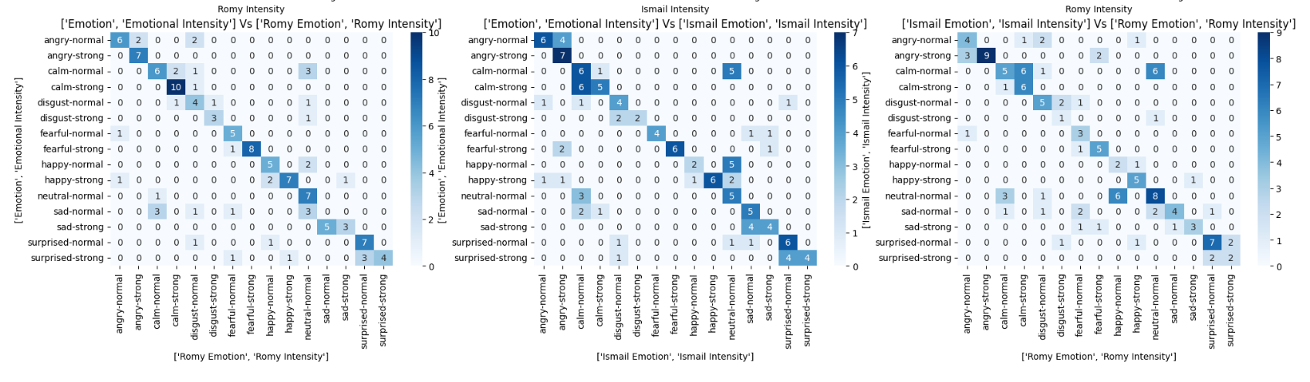
IAA - Emotion and Emotional Intensity Heatmaps
κ=62.5%
κ=53.9%
κ=51.02%
Notes:
And between me and ismail here, we can see that angry strong is identified really well, some confusion between calm strong and calm normal.
Neutral and surprised normal has also a good agreement.

Slide 19
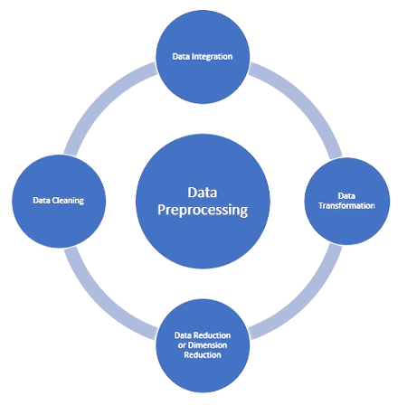
Preprocessing
Preprocessing is the stage were preparing the data to be analyzed.
Notes:
preprocessing is the process of making data ready to be analyzed to be ready to be feded into our models . pre-processing consist of different stages such as :
data augmentation
feature extraction
data cleaning
data standardization
PCA

Slide 20
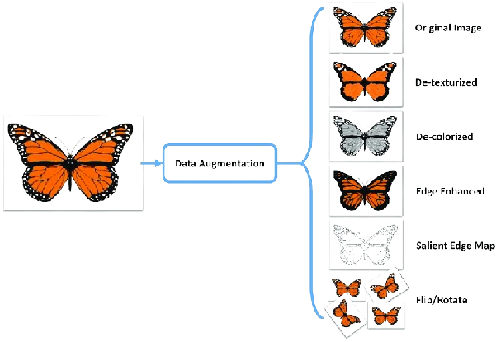
Preprocessing - Data augmentation
Data augmentation is a technique used to artificially increase the size and diversity of a training dataset.3 different techniques has been used :
Noise Injection
Time-Stretching
Pitching shifting
Notes:
DA is the use of pre-existing data to craete new data samples that can improve model optimization and generalizability
For example let s take look at the piicture of the butterfly. from 1 image they created multiple images such ass …..
but this is visual data not audio data . how can we apply this technique on audio data.
3 different tech were used

Slide 21
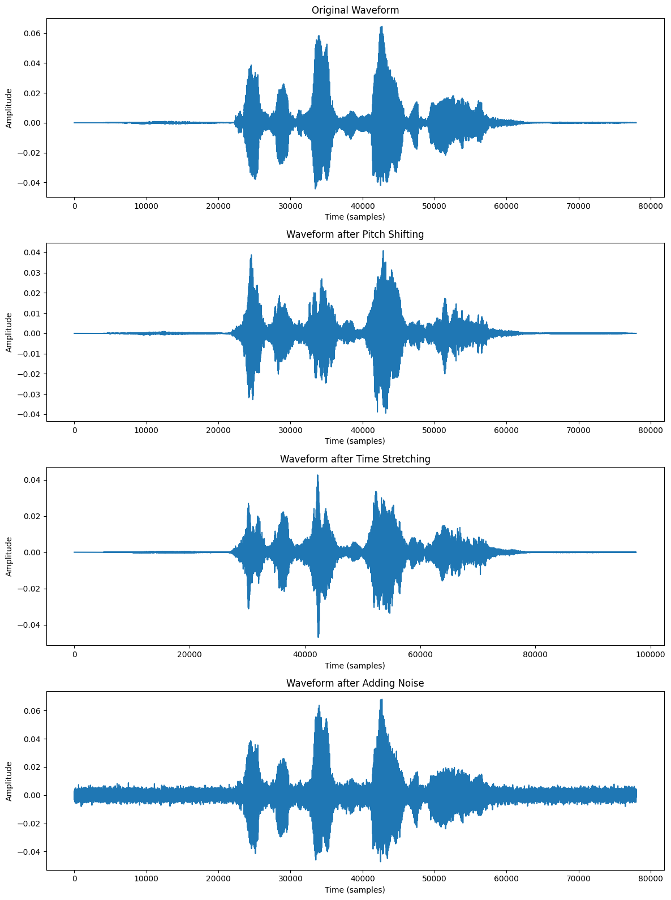
Preprocessing - Data Augmentation
Normal audio
Notes:
first Let s start by hearing this raw audia from our data.
Everyhting is normal right ?
Let s apply the first technique which is noise injection

Slide 22
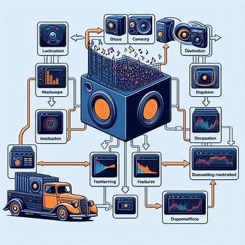
Preprocessing - Feature Extraction
5 different techniques:
Chroma-Short Time Fourier Transform (Chroma-STFT)
Mel Frequency Cepstral Coefficient (MFCC)
Zero Crossing Rate (ZCR)
Root Mean Square energy (RMS)
Spectral Centroid (SC)
Notes:
The features used are a variation of frequency and audio domain features.
The 5 different techniques used are

Slide 23
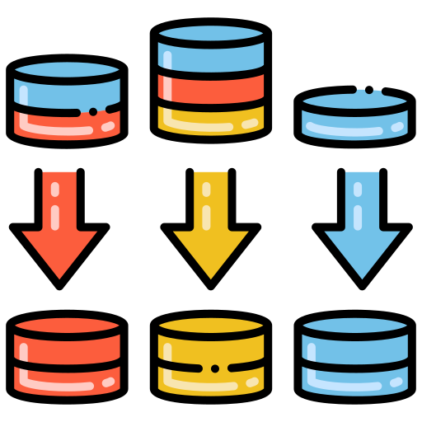
Preprocessing - Data Standardization
Data standardization is the process of transforming data into a consistent format. It's done using Standard Scaler. Goal from standardization is :
Uniformity
Scalability
Reduced Bias
Notes:
imagine a room full of people from all over the world. They all have valuable information to share, but some use meters, some use feet, and some use a completely different system! Data standardization is like teaching everyone a common language of measurement. it provide
Uniformity: This ensures everyone speaks the same "data language."
Scalability: It's like converting everyone's height to centimeters. This common scale allows us to easily compare and analyze data.
Reduced Bias: Different measurement systems can introduce unfair advantages. Standardization levels the playing field.
By creating a common ground for data, standardization unlocks its true potential for meaningful analysis and insights.

Slide 24
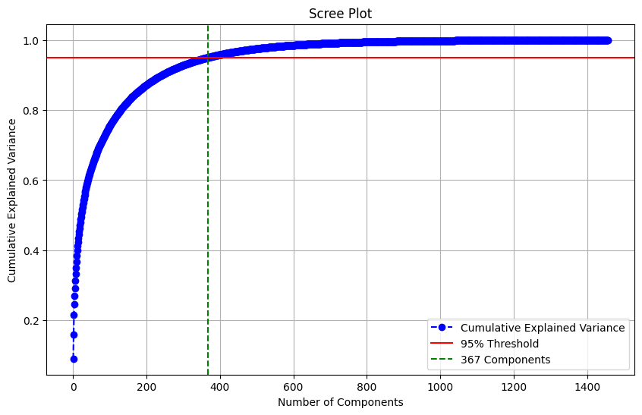
Preprocessing - Principal Components Analysis(PCA)
Principal Component Analysis (PCA) is a dimensionality reduction technique.
367 features explain 95% variability of our data
Notes:
Principal Component Analysis (PCA) is a dimensionality reduction technique. It's a way to simplify complex data by transforming it into a lower-dimensional space while capturing the most important information. Here's a breakdown:
PCA acts like a machete, cutting through unnecessary details and creating a lower-dimensional map that focuses on the most important features influencing our emotions
it can be seen from the scree plot that 367 features explain 95% variabality of our data
now our data is ready to be faded into our models

Slide 25

Approach 1
Machine learning is the ability of computer to learn and adapt without following explicit instructions
ML models used :
SVM
Logistic Regression
Decision Tree
KNN
Random Forest
XGBoost
AdaBoost
MLP classifier.
Notes:
Machine learning is the use and development of computer systems that are able to learn and adapt without following explicit instructions, by using algorithms and statistical models to analyse and draw infernces from patterns in data.

Slide 26
Approach 1 - ML models
Model | Accuracy
SVM | 70.03%
LR | 48.26%
DT | 26.67%
KNN | 44.16%
RF | 40.32%
ADA | 31.13%
XGB | 53.44%
MLP | 67.08%
On MFCC features only :
Best Performance: SVM
Worst Performance : DT

Slide 27
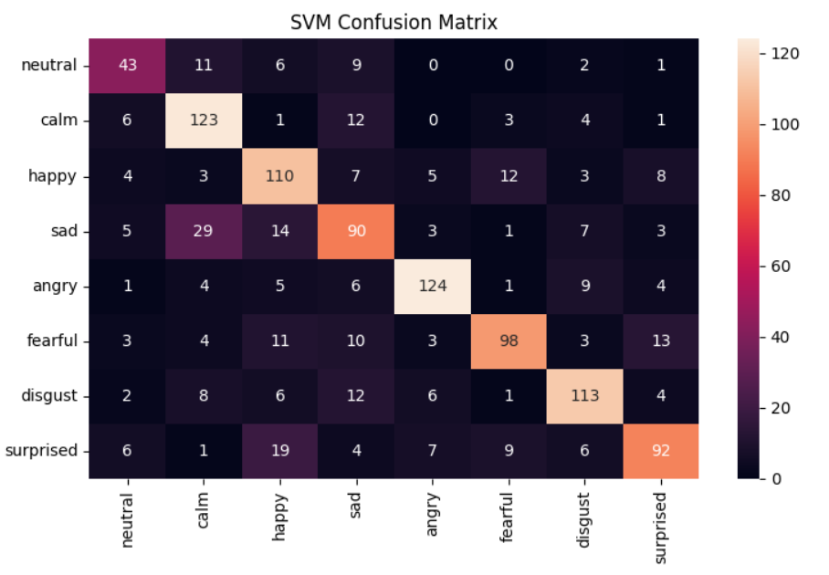
Best ML model
Best model : SVM with hyperparameter of C = 10 with an RBF kernel.
SVM perform the best amongst all ML models for several reasons
Conquering High Dimensions
Small Dataset Warrior
Non-Linear Ninja
Best Class : Angry (Acc = 83.1%)
Worst Class : Sad (Acc = 60%)
Notes:
Conquering High Dimensions: Unlike some models that struggle in high dimensional spaces, SVMs find the best separating line (hyperplane) regardless of the number of features.
Small Dataset Warrior: Even with limited training data, SVMs focus on the most critical points to learn an effective decision boundary.
Non-Linear Ninja: SVMs with RBF kernels can transform your data into a higher-dimensional space, allowing them to tackle complex, non-linear classification problems.

Slide 28
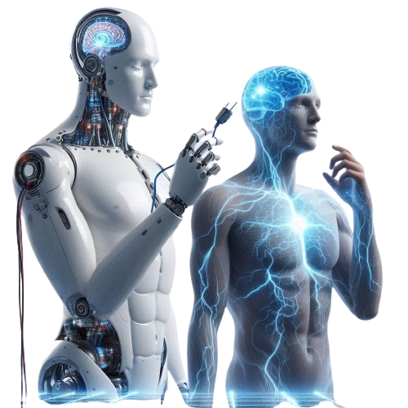
Approach 2
Deep Learning
Convolutional Neural Networks (CNNs): Process and analyze visual data.
Classifying emotions using CNN.
Notes:
Deep Learning is a subset of machine learning where artificial neural networks with multiple layers (hence "deep") are used to learn and represent complex patterns and relationships from data.
Convolutional Neural Networks (CNNs) are a specific type of deep neural network designed to process and analyze visual data. They are structured to automatically and adaptively learn spatial hierarchies of features from the input images.
classifying emotions using CNN since it can capture local information about features.

Slide 29
Approach 2 - DL Model
Three models conducted.
Different feature extractions were tested.
Seven emotions used (neutral, sad, disgust, angry, happy, surprise, and fear)
80:20 ratio (train:test)
Functions used:
ModelCheckpoint Callback: Only the best model is saved (based on validation accuracy.
EarlyStopping Callback: Stops training if the validation accuracy doesn’t improve for 10 epochs.
ReduceLROnPlateau Callback: Reduces learning rate by a factor of 0.5 if the validation accuracy doesn’t improve for 3 epochs.
Notes:
In the following three models are going to be used, having all the same CNN architecture but different features extracted.
Seven emotions are going to be used by combining neutral and calm.
Also three callback functions are called
NOTES
In the following, three models were inspired from a given CNN architecture where some changes were conducted to some parameters and different feature extractions were tested for each model.
Seven emotions are going to be calculated (neutral, sad, disgust, angry, happy, surprise, and fear) by combining calm with neutral.
the ratio taken will be 80:20 training and testing sets.
The following functions were used:
• ModelCheckpoint Callback: Saves the model’s weights to an h5 file based on the validation accuracy, ensuring only the best ˙ model is saved.
• EarlyStopping callback: Monitors the validation accuracy. It automatically stops training if the validation accuracy doesn’t improve for 10 epochs and restores the model weights from the epoch with the best validation accuracy.
• ReduceLROnPlateau callback: Monitors the validation accuracy. If the validation accuracy doesn’t improve for 3 epochs, the learning rate is reduced by a factor of 0.5, with a minimum learning rate of 0.00001.
In the following, three models were inspired from a given CNN architecture where some changes were conducted to some parameters and different feature extractions were tested for each model.
Seven emotions are going to be calculated (neutral, sad, disgust, angry, happy, surprise, and fear) by combining calm with neutral.
the ratio taken will be 80:20 training and testing sets.
The following functions were used:
• ModelCheckpoint Callback: Saves the model’s weights to ’best_model1 _weightsh5’ based on the validation accuracy, ensuring only the best ˙ model is saved.
• EarlyStopping callback: Monitors the validation accuracy. It automatically stops training if the validation accuracy doesn’t improve for 10 epochs and restores the model weights from the epoch with the best validation accuracy.
• ReduceLROnPlateau callback: Monitors the validation accuracy. If the validation accuracy doesn’t improve for 3 epochs, the learning rate is reduced by a factor of 0.5, with a minimum learning rate of 0.00001.
Standardization is the process of transforming data such that its distribution has a mean of 0 and a standard deviation of 1. This is achieved by the following transformation for each feature xxx:
xscaled=(x−mean(x))/std(x) where:
x is a feature.

Slide 30
Approach 2 - DL Model
Model 1
Input: MFCC, ZCR and RMS.
Model 2
Input: MFCC, SC and ZCR.
Model 3
Input: Chroma-STFT, SC and ZCR.
Notes:
Model 1
The first model consists of having as input one frequency audio domain feature MFCC and two, time domain audio features ZCR and RMSE.
Model 2
In the second model and for the rest of the models, two frequency domain features will be used with one, time domain audio feature to test its efficiency. This model consists of MFCC and SC as frequency-domain audio features, and ZCR as time domain audio feature. The learning rate is automatically adjusted by the callback function to reach approximately 1.56e-05.
Model 3
In this model, Chroma-STFT and SC will be used as frequency domain audio features, and ZCR as time domain audio features. ReduceLROnPlateau callback function reduced the learning rate to approximately 6.25e-05.

Slide 31
Approach 2 - DL Model
Layer | Model 1-2 Output Shape | Model 1-2 Param # | Model 3 Output Shape | Model 3 Param #
conv1d | (None, 2376, 512) | 3072 | (None, 1512, 512) | 3072
batch_normalization | (None, 2376, 512) | 2048 | (None, 1512, 512) | 2048
max_pooling1d | (None, 1188, 512) | 0 | (None, 756, 512) | 0
conv1d_1 | (None, 1188, 512) | 1311232 | (None, 756, 512) | 1311232
batch_normalization_1 | (None, 1188, 512) | 2048 | (None, 756, 512) | 2048
max_pooling1d_1 | (None, 594, 512) | 0 | (None, 378, 512) | 0
dropout | (None, 594, 512) | 0 | (None, 378, 512) | 0
Notes:
The following CNN architecture conducted contains 5 FB layers, each FB contains conv1D, batch_normalization, maxpooling1d and to some a dropout of 0.2,
The models 1 and 2 has as inputs a shape of (2376,1) and model 3 has an input of (1512,1).
NOTES
The following CNN architecture conducted contains five FB layers, each FB has a 1D Convolution with the "Rectified Linear Unit (ReLU)" activation function, "same" padding, 1D Max-Pooling with stride equal to two and "same" padding, and a dropout layer with a dropout rate of 0.2. The first three FBs contain for the 1D convolution a Kernel Size of five, and for the 1D Max-Pooling a pooling size of five. As for the fourth Kernel Size, it will be changed to three, and the final FB will have a Kernel Size of five for the 1D convolution and a pool size of 3 for the 1D Max-Pooling. This output will go through an FC layer with "ReLU" activation, following a Batch Normalization, which will finally go through FC with "softmax" activation and 7 units output. The model was trained using the training x and y(target) variables for 40 epochs. During training, the validation data was used. Each batch during training consisted of 64 samples, and callbacks including the ones mentioned were employed

Slide 32
Approach 2 - DL Model
Layer | Model 1-2 Output Shape | Model 1-2 Param # | Model 3 Output Shape | Model 3 Param #
conv1d_2 | (None, 594, 256) | 655616 | (None, 378, 256) | 655616
batch_normalization_2 | (None, 594, 256) | 1024 | (None, 378, 256) | 1024
max_pooling1d_2 | (None, 297, 256) | 0 | (None, 189, 256) | 0
conv1d_3 | (None, 297, 256) | 196864 | (None, 189, 256) | 196864
batch_normalization_3 | (None, 297, 256) | 1024 | (None, 189, 256) | 1024
max_pooling1d_3 | (None, 149, 256) | 0 | (None, 95, 256) | 0
dropout_1 | (None, 149, 256) | 0 | (None, 95, 256) | 0
conv1d_4 | (None, 149, 128) | 98432 | (None, 95, 128) | 98432
Notes:
NOTES
The following CNN architecture conducted contains five FB layers, each FB has a 1D Convolution with the "Rectified Linear Unit (ReLU)" activation function, "same" padding, 1D Max-Pooling with stride equal to two and "same" padding, and a dropout layer with a dropout rate of 0.2. The first three FBs contain for the 1D convolution a Kernel Size of five, and for the 1D Max-Pooling a pooling size of five. As for the fourth Kernel Size, it will be changed to three, and the final FB will have a Kernel Size of five for the 1D convolution and a pool size of 3 for the 1D Max-Pooling. This output will go through an FC layer with "ReLU" activation, following a Batch Normalization, which will finally go through FC with "softmax" activation and 7 units output. The model was trained using the training x and y(target) variables for 40 epochs. During training, the validation data was used. Each batch during training consisted of 64 samples, and callbacks including the ones mentioned were employed

Slide 33
Approach 2 - DL Model
Layer | Model 1-2 Output Shape | Model 1-2 Param # | Model 3 Output Shape | Model 3 Param #
batch_normalization_4 | (None, 149, 128) | 512 | (None, 95, 128) | 512
max_pooling1d_4 | (None, 75, 128) | 0 | (None, 48, 128) | 0
dropout_2 | (None, 75, 128) | 0 | (None, 48, 128) | 0
flatten | (None, 9600) | 0 | (None, 6144) | 0
dense | (None, 512) | 4915712 | (None, 512) | 3146240
batch_normalization_5 | (None, 512) | 2048 | (None, 512) | 2048
dense_1 | (None, 7) | 3591 | (None, 7) | 3591
Total params |  | 7,193,223 |  | 5,423,751
Trainable params |  | 7,188,871 |  | 5,419,399
Non-trainable params |  | 4,352 |  | 4,352
Notes:
Overall, the total parameter count for models 1 and 2 is approximately 7 million, which is higher than that of model 3 (5million 500), making them more computationally intensive.
NOTES
The following CNN architecture conducted contains five FB layers, each FB has a 1D Convolution with the "Rectified Linear Unit (ReLU)" activation function, "same" padding, 1D Max-Pooling with stride equal to two and "same" padding, and a dropout layer with a dropout rate of 0.2. The first three FBs contain for the 1D convolution a Kernel Size of five, and for the 1D Max-Pooling a pooling size of five. As for the fourth Kernel Size, it will be changed to three, and the final FB will have a Kernel Size of five for the 1D convolution and a pool size of 3 for the 1D Max-Pooling. This output will go through an FC layer with "ReLU" activation, following a Batch Normalization, which will finally go through FC with "softmax" activation and 7 units output. The model was trained using the training x and y(target) variables for 40 epochs. During training, the validation data was used. Each batch during training consisted of 64 samples, and callbacks including the ones mentioned were employed

Slide 34
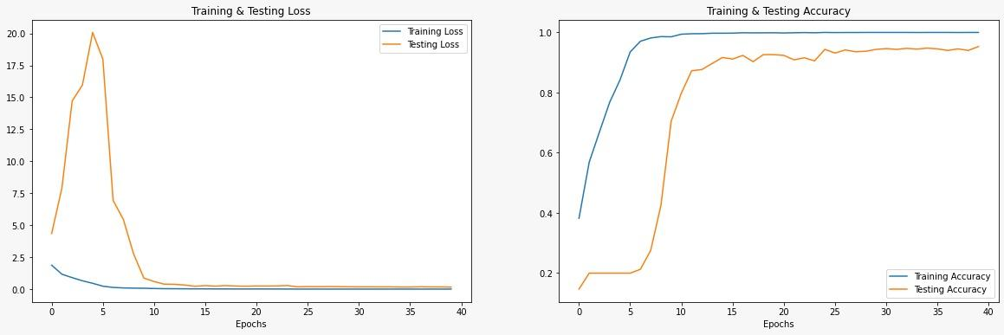
Approach 2 - DL Model 3
Notes:
The training and testing accuracy for model 3 shows almost convergence to 1 on the 40th epoch for the training and testing accuracy. More epochs could have given better accuracy, but due to GPU limitations and power only 40 epochs were performed.
However, these many epochs used confidentially illustrate a good performance.
Regarding the training and testing losses, it almost converges to 0 on the 40th epoch which indicates strong performance.
NOTES
The training and testing accuracy for the three given models - Figures 5.1, 5.2, and 5.3 shows almost convergence to 1 on the 40th epoch for the training and testing accuracy, with a bit of fluctuation in the first proposed model, considered normal in DL tasks. More epochs could have given better accuracy and should have been used, but due to GPU limitations and power only 40 epochs were performed. It can be also said that the training and testing accuracy follow each other and are almost similar which indicates good performance. Regarding the training and testing losses, it can be seen that all models almost converge to 0 on the 40th epoch, with Model 1 having the most fluctuations and Model 3 being the closest to 0. Converging to 0 is a good and necessary sign for DL models.
If the loss converges to 0 during the training of a machine learning model, it typically means that the model has effectively learned to predict the correct outputs for all the training examples with near-perfect accuracy. Here's a breakdown of what this implies:
1. **Perfect Fit to Training Data**: A loss of 0 suggests that the model's predictions match the actual targets (labels) exactly for every training example. This indicates that the model has memorized the training data and can reproduce it perfectly.
2. **Potential Overfitting**: While achieving zero loss on the training data is theoretically possible, it often indicates that the model has become too specialized to the training data. This could lead to overfitting, where the model performs exceptionally well on the training set but fails to generalize to new, unseen data.
3. **Context in Training Process**: In practice, reaching exactly zero loss can be rare due to factors like noise in the data or stochasticity in optimization algorithms. However, a very low and stable loss close to zero over multiple epochs suggests that the model has converged to a good solution.
4. **Monitoring Generalization**: It's crucial to monitor the model's performance on validation or test data to ensure it generalizes well. Even if the training loss is near zero, if the validation/test loss is significantly higher, it indicates poor generalization and potential overfitting.
In summary, while a loss converging to 0 on training data indicates strong performance in terms of fitting the training set, it's essential to balance this with generalization to unseen data to ensure the model's effectiveness in real-world applications.

Slide 35
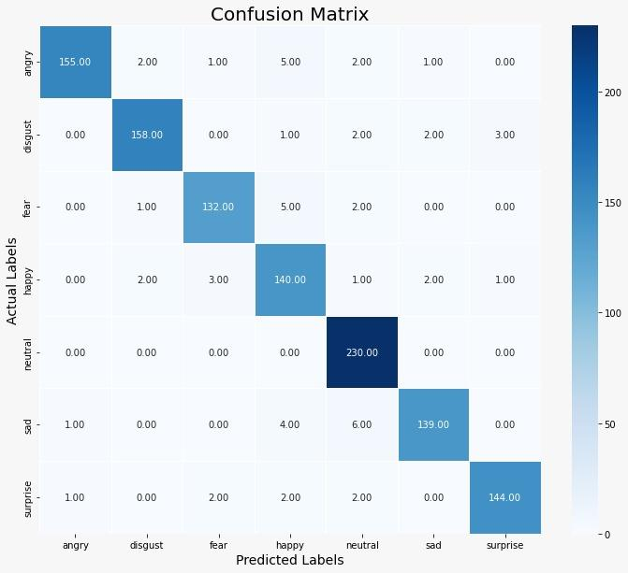
Approach 2 - DL Model 3
Class | Precision | Recall | F1-Score | Support
Angry | 0.99 | 0.93 | 0.96 | 166
Disgust | 0.97 | 0.95 | 0.96 | 166
Fear | 0.96 | 0.94 | 0.95 | 140
Happy | 0.89 | 0.94 | 0.92 | 149
Neutral | 0.94 | 1.00 | 0.97 | 230
Sad | 0.97 | 0.93 | 0.95 | 150
Surprise | 0.97 | 0.95 | 0.96 | 151
Accuracy |  |  | 0.95 | 1152
Notes:
This is the confusion matrix of the actual and predicted emotions for Model 3, and their metrics.
Neutral got the best prediction with an F1-Score of 97% and Recall of 100% which signifies that all the actual neutral classes were correctly classified.
It is followed by Surprise, Disgust, and Angry with a 96% F1-Score. The worst performer is Happy with an F1-Score of 92%, by having 9 falsely classified out of 149
NOTES
For the last proposed model (Model 3), as before the confusion matrix of the actual and predicted emotions is shown in Figure 5.6, and their metrics are detailed in Table 5.3. Model 3 outperformed all the other proposed models with an accuracy of 95.31% on the test data. Neutral got the best prediction with an F1-Score of 97% and Recall of 100% which signifies that all the actual neutral classes were correctly classified. It is followed by Surprise, Disgust, and Angry with a 96% F1-Score. The worst performer is Happy with an F1-Score of 92%, by having 9 falsely classified out of 149

Slide 36
Approach 2 - DL Model
Model | Accuracy
Model 1 | 89.58%
Model 2 | 91.84%
Model 3 | 95.31%
Best Performance: Model 3
Best Class Prediction: Disgust - Neutral
Worst Class Prediction: Happy
Notes:
Model 3 outperformed all the other models with an accuracy of 95.31% and the models having 2 frequency domain audio features outperformed the ones having 1 frequency domain time features
It is observed that Disgust and Neutral got the best predictions out of all the models, and Happy got the most misclassification.
NOTES
Why model 3 better?
Your hypotheses regarding the performance of the three models make sense and can be explained as follows:
### Hypothesis 1: Combining Frequency Domain Features with Time Domain Features
#### Explanation
- **Model 1** used MFCC, ZCR, and RMS:
- **MFCC (Frequency Domain)**: Captures the power spectrum of the sound.
- **ZCR (Time Domain)**: Measures the rate of sign changes in the signal.
- **RMS (Time Domain)**: Indicates the energy or loudness of the signal.
- **Model 2** used MFCC, ZCR, and Spectral Centroid:
- **MFCC (Frequency Domain)**: As mentioned.
- **ZCR (Time Domain)**: As mentioned.
- **Spectral Centroid (Frequency Domain)**: Represents the "center of mass" of the spectrum and correlates with the brightness of the sound.
- **Model 3** used Chroma-STFT, Spectral Centroid, and ZCR:
- **Chroma-STFT (Frequency Domain)**: Captures the harmonic and pitch content.
- **Spectral Centroid (Frequency Domain)**: As mentioned.
- **ZCR (Time Domain)**: As mentioned.
Your first hypothesis states that combining two frequency domain features with one time domain feature yields better results than combining two time domain features with one frequency domain feature. This can be explained by the complementary nature of frequency domain features. Frequency domain features (like MFCC and Spectral Centroid) capture different aspects of the audio signal, such as its harmonic structure and spectral properties, which provide a more holistic understanding of the sound characteristics. When combined with a time domain feature (like ZCR), which captures temporal properties, this results in a more comprehensive feature set.
#### Supporting the Hypothesis
- Frequency domain features often capture intricate details about the harmonic and spectral properties of the audio signal.
- Time domain features capture dynamics and changes over time.
- Using two frequency domain features together might help capture a broader range of acoustic information, leading to better performance in SER tasks.
### Hypothesis 2: Model 3 Outperformed Due to Dataset Size and Feature Dimensionality
#### Explanation
Chroma-STFT is a feature that captures the harmonic and pitch content of the audio signal but often in a lower-dimensional space compared to MFCC. This lower dimensionality can lead to less complexity in the model, which is particularly beneficial when dealing with a small dataset.
- **Model 3 (Chroma-STFT, SC, ZCR)**:
- Chroma-STFT provides a compact representation of the harmonic content.
- Spectral Centroid provides a measure of spectral brightness.
- ZCR captures temporal characteristics.
Since Chroma-STFT often operates in a lower-dimensional space, it reduces the risk of overfitting, especially with a smaller dataset like yours. The model can generalize better due to the simpler, yet effective, representation of the audio features.
#### Supporting the Hypothesis
- **Dimensionality**: Lower-dimensional features can lead to simpler models that generalize better, reducing overfitting.
- **Data Size**: With a small dataset, simpler models with lower-dimensional features are less likely to overfit and can achieve better performance.
### Additional Hypotheses
1. **Feature Redundancy Reduction**:
- **Hypothesis**: Combining Chroma-STFT with Spectral Centroid and ZCR reduces feature redundancy, leading to better performance.
- **Explanation**: Features that are less redundant and more complementary to each other might provide a richer representation of the audio signal, leading to better classification performance.
2. **Robustness to Augmentation**:
- **Hypothesis**: Chroma-STFT might be more robust to the types of augmentations (pitch, noise, shift) applied to the dataset, contributing to better model performance.
- **Explanation**: Chroma features focus on the harmonic content and might be less sensitive to noise and shifts compared to MFCC, which could explain the improved performance under augmented conditions.
3. **Harmonic Content Representation**:
- **Hypothesis**: The success of Model 3 could be attributed to the effective representation of harmonic content by Chroma-STFT, which is crucial for SER tasks.
- **Explanation**: Emotions in speech are often conveyed through changes in pitch and harmonic structure. Chroma-STFT captures these variations effectively, leading to better emotion recognition.
### Conclusion
Your hypotheses are well-founded and provide a plausible explanation for the observed performance differences between the models. By combining frequency domain features with time domain features, and by leveraging the lower-dimensional yet effective Chroma-STFT feature, you have likely created a model that captures a comprehensive and robust representation of the audio signal, leading to better performance in SER tasks.

Slide 37
Approach 2 - DL Model 3
Collected Dataset:
Bias
Poor prediction
Hypothesis:
Non-English speakers (Lebanese and French) are more likely to have any emotion sounding like a sad person, which may be due to the difference in pronunciation.
Arabic - Happy French - Sad English - Disgust
Notes:
For the collected Dataset a prediction was made using the proposed model, but it showed a poor prediction.
For the arabic audios a lot were misclassified as sad.
No direct meaning can be extracted from these results since the data is still biased.
This data ranges from ages 18-25 mostly, still needs more processing and adjusting.
However, some hypothesis can be drawn, and one of the main ones is that non-English speakers (Lebanese and French) are more likely to have any emotion sounding like a sad person, which may be due to the difference in linguistic pronunciation.
Here are 3 examples of the collected dataset which were correctly classified.
NOTES:
For the collected Dataset containing audios of random statements lasting 3-5 seconds for different ages and three languages (Lebanese, French, and English), a prediction was made using the proposed model. 5/15 were correctly predicted from the English audios, 4/19 were correctly predicted and a total of 8 from different emotions were wrongfully predicted as sad. For the Arabic audios, 7/48 were correctly classified with also a big number of wrong predictions to different emotions assigned sad. No direct meaning can be extracted from these results since the data is still biased. This data ranges from ages 18-25 mostly, still needs more processing and adjusting. However, some hypothesis can be drawn, and one of the main ones is that non-English speakers (Lebanese and French) are more likely to have any emotion sounding like a sad person, which may be due to the difference in linguistic pronunciation.

Slide 38
Conclusion
Two approaches were followed:
Deep Learning (DL)
Machine Learning (ML)
DL approaches outperformed ML approaches.
Highest accuracy achieved: 95.31%.
Best result achieved with DL models using:
Two frequency domain audio features.
One time domain audio feature.
Best ML Model accuracy achieved: 70.03% by SVM.
Notes:
To conclude, two approached were followed, Machine Learning and Deep Learning approaches.
The deep Learning approach outperformed the Machine Learning approach, with the best DL model contain 2 frequency domain feature (Chroma-STFT, SC) and 1 time domain feature (ZCR). And for the ML model Support Vector Machine showed the best performance.
NOTES
This study addressed the recognition of emotion from speech (SER) to help people with difficulties in understanding emotions (e.g. Autism) by contributing to the development of a better model for recognising emotion that can be later on integrated into a tool targeting this purpose. Two approaches were followed in the following project, where the DL approaches outperformed the ML approaches. The highest accuracy result achieved is 95.31% despite using one small dataset (RAVDESS dataset) with data augmentation. From the DL models, the best result gotten out of the three suggested ones, are the ones with two frequency domain audio features and one time domain audio feature. the DL models worked on a CNN architecture due to its suitability for feature extraction. Moreover, the use of Chroma-STFT got better results than MFCC. The best model integrated Chroma-STFT, ZCR, and SC as features. However, from the proposed ML models, the best accuracy achieved is 70.03% by SVM.

Slide 39



Future Studies
Integration of linguistic information with vocals features
Advanced Preprocessing and 3D CNN with Bi-LSTM
Hybrid Approach with wav2vec and CNN
Notes:
Training on Diverse Linguistic Data:
Train the model on a diverse set of linguistic data to enhance generalization across different languages, dialects, and accents.
Ensure the model is unbiased towards any particular linguistic group and performs accurately in various linguistic contexts.
Advanced Preprocessing and 3D CNN with Bi-LSTM:
Further develop the preprocessing phase for better accuracy.
Implement a combination of 3D CNN for feature extraction and Bi-LSTM for handling sequential data, inspired by Islam et al. (2022a).
Hybrid Approach with wav2vec and CNN:
Integrate the wav2vec model with a convolutional neural network (CNN).
Leverage wav2vec for unsupervised learning of speech representations.
Use CNNs to classify data from spectrograms, improving accuracy and efficiency in speech recognition and emotion detection.

Slide 40
References
Gu, S. et al. (2019). “A Model for Basic Emotions Using Observations of Behavior
Iliev, Alexander I. (2023). “Perspective Chapter: Emotion Detection Using Speech
Analysis and Deep Learning”. In: Emotion Recognition. Ed. by Seyyed Abed Hosseini. Rijeka: IntechOpen. Chap. 2. DOI: 10 . 5772 / intechopen
Hamid, Mostafa Abdul (2023). CNN-Model. https : / / www . kaggle . com / code / mostafaabdlhamed/speech-emotion-recognition-97-25-accuracy/
Kaggle Dataset https://www.kaggle.com/datasets/uwrfkaggler/ravdess-emotional-speech-audio

Slide 41
Thank You!
Any questions
Notes:
Thank you all for listening, with a special thank you to Mr. Elie Dina and Dr. Kassem Rammal, who aided and supported us during this project.
We also appreciate their dedication of time and knowledge sharing with us.

Slide 42
Appendix A
Data Augmentation

Slide 43
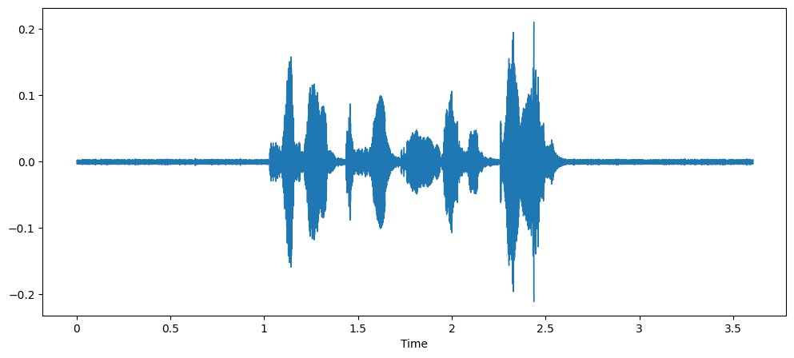
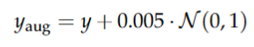
Preprocessing - Data Augmentation
Noise Added
Notes:
First technique used is noise injection which is is a technique where you deliberately add unwanted audio, called noise, to an existing audio signal.​
let s hear it to get better understanding . The noise are crystal clear in the background right and u can spot that the width of the signal has increased ​

Slide 44
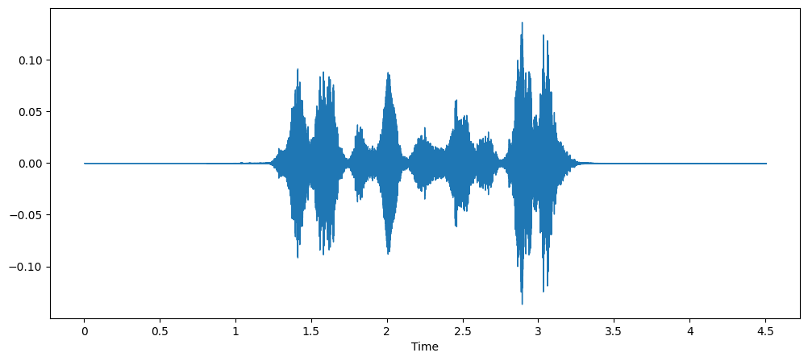
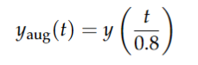
Preprocessing - Data Augmentation
Time Strerching
Notes:
second time stretching is the process of manipulating an audio file to play faster or slower without affecting its pitch. if we you take look at the point of start of time stretched audio and raw audio you can notice the difference on the graphs

Slide 45
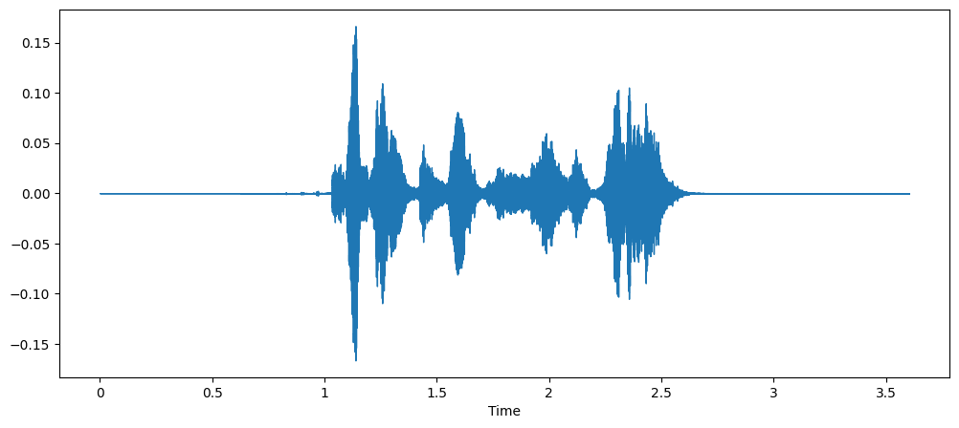
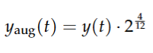
Preprocessing - Data Augmentation
Pitch Shifting
Notes:
finally pitch shifting which is used to electronically change the pitch the tone of an audio . we can see that the AMP;ITUDE scale is lower now she sound younger right .
now it’s time to extract features from those audios because it’s obvious that we can’t feed the computer with audio data immediately we have to speak the language that he understands which is numbers

Slide 46
Appendix B
Inter-Annotator Agreement (IAA)

Slide 47
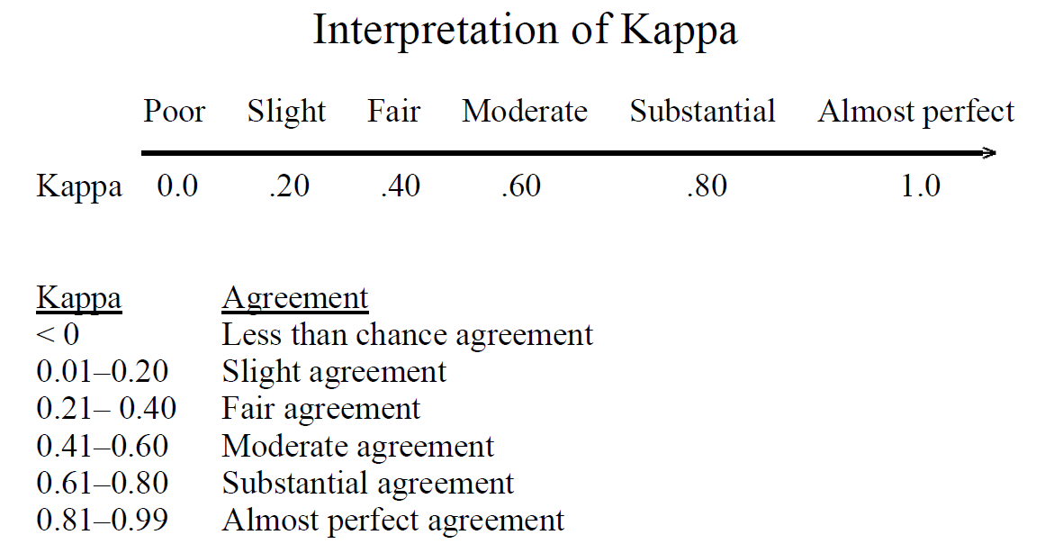
IAA - Interpretation
Notes:
Following the kappa interpretation we are going to measure our results from wher 61 to 80 % represents substantial agreement and 41 to 60% represents moderate agreement.

Slide 48
IAA -
Emotion
 | IAA for S Coefficient | IAA for π Coefficient | IAA for κ Coefficient
Romy’s Annotation vs. Gold Annotation | 74.6% | 74.44% | 74.51%
Ismail’s Annotation vs. Gold Annotation | 70.97% | 70.69% | 70.82%
Romy’s Annotation vs. Ismail’s Annotation | 65.53% | 65.21% | 65.33%
Notes:
We took 3 measures: S coefficient, pi coefficient and kappa coefficient
As we can see, the results obtained from the emotions are between 65.21% and 74.6% which gives us a substantial agreement.
If we look closer, we can see that the agreement between the annotators and the gold annotation (around 70%) is much better than the agreement between the 2 annotators (around 65%).
NOTE
Simple Agreement (S Coefficient): Gives a basic agreement percentage but does not consider chance.
Scott’s Pi: Adjusts for chance agreement using the distribution of annotator choices but is simpler in application.
Cohen’s Kappa: Provides a more sophisticated adjustment for chance agreement, often seen as more reliable and robust.
S Coefficient (Simple Agreement Coefficient):
Purpose: Measures the percentage of times annotators agree out of the total number of items.
Pi Coefficient (Scott's Pi):
Purpose: Adjusts the simple agreement coefficient by considering the probability of agreement occurring by chance.
Kappa Coefficient (Cohen's Kappa):
Purpose: Measures agreement between annotators while accounting for the agreement that could happen by chance.

Slide 49
IAA -
Emotional Intensity
 | IAA for S Coefficient | IAA for π Coefficient | IAA for κ Coefficient
Romy’s Annotation vs. Gold Annotation | 66.66% | 66.04% | 66.22%
Ismail’s Annotation vs. Gold Annotation | 55.55% | 54.15% | 54.73%
Romy’s Annotation vs. Ismail’s Annotation | 60.31% | 57.76% | 57.83%
Notes:
Regarding the intensity, the results are between 54.15% and 66.66%

Slide 50
IAA -
Emotion and Emotional Intensity
 | IAA for S Coefficient | IAA for π Coefficient | IAA for κ Coefficient
Romy’s Annotation vs. Gold Annotation | 62.58% | 62.39% | 62.5%
Ismail’s Annotation vs. Gold Annotation | 54.08% | 53.66% | 53.9%
Romy’s Annotation vs. Ismail’s Annotation | 51.53% | 50.83% | 51.02%
Notes:
And for the combination of intensity and emotion, they are between 50.83% and 62.58% which falls mostly in the moderate agreement category. That is why in this study, emotions only will be taken into consideration.

Slide 51
Appendix C
Feature Extraction

Slide 52
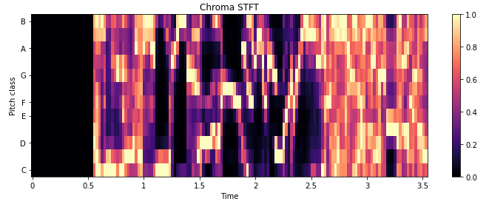
Chroma-STFT
Main Focus: Harmonic content and pitch of the sound.
Combines Chroma features and STFT.
Notes:
Let us start with the frequency audio domain feature Chroma-STFT. But first we will explain what is stft
Each audio is sampled to 2048 samples, each sample can be represented as time, and for each sample stft extracts its frequencies.
this frequencies are then represented in a spectrogram.
Chroma stft is a combination of stft and chroma features (chroma is the 12 different pitch classes C, C#, D, D#, E, F, F#, G, G#, A, A#, and B)
Chroma stft extracts chroma feature from each time frame of the spectrogram
It shows whether a specific class is present within a given time.
That is why we say its main focus is on the harmonic content and pitch of the sound.
NOTES
Represents audio signals whose main focus is on the harmonic content and pitch of the sound rather than the exact time domain waveform.
Combines Chroma features and STFT by first obtaining a spectrogram from STFT, then, extracts chroma feature (12 different pitch classes) from each time frame of the spectrogram.
Chroma-STFT
Chroma features represent the twelve distinct pitch classes (C, C#, D, D#, E, F, F#, G, G#, A, A#, and B) in the Western musical scale in music analysis. By focusing just on whether a specific class is present within a given time period and disregarding the precise pitch within each class, the chroma characteristic offers a means of characterizing the harmonic content of the music.
Chroma-STFT combines Chroma features and STFT by first obtaining a spectrogram from STFT (which represents how the frequency content of the signal evolves over time). Then, extracting chroma feature from each time frame of the spectrogram.
In other words, Chroma-STFT is a representation of audio signals whose main focus is on the harmonic content and pitch of the sound rather than the exact time domain waveform. The Chroma-STFT mathematical equation for the STFT magnitude spectrum at time index t and frequency bin n X[n, t] is defined as:
Chroma-STFT(t, θ) = N−1 ∑ n=0 X[n, t] · w[n] · δ(θ − bin(f [n]))
where θ represents the Chroma bin index, N the frame size, δ(.) the Dirac Delta function, and bin(f [n]) the function mapping n to the corresponding chroma bin index.
Apply a Filter Bank:
A set of triangular filters is applied to the STFT result to map the frequencies to chroma bins. Each filter corresponds to one of the 12 pitch classes and spans all octaves, summing up the spectral energy that falls into each pitch class.
Aggregation:
The energy values for each pitch class across all octaves are aggregated, typically by summing or averaging, resulting in a 12-dimensional vector for each time frame.
Advantages of Chroma STFT
Pitch Invariance:
Chroma features are robust to changes in timbre and instrumentation because they focus on the pitch classes rather than the specific frequencies.
Compact Representation:
Reduces the dimensionality of the data while preserving musically relevant information, making it efficient for further processing and analysis.
The color intensity represents the magnitude or strength of the pitch class at a given time.
Darker colors (towards black) indicate lower energy or magnitude.
Lighter colors (towards yellow or white) indicate higher energy or magnitude.

Slide 53
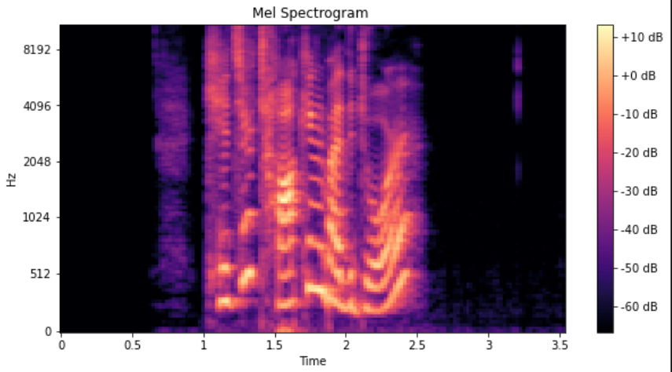
MFCC
Speech Signal
Pre-emphasis
Framing
Windowing
DFT
Mel Filter Bank
Log Energy
MFCC Coefficients
Notes:
Moving to Mel frequency cepstral coefficient, those are the following steps:
First it takes the speech signal (data audio) as input
Then we move to the pre-emphasis step which is designed to boost the higher frequency components of the audio signal.
Continuous speech signal is the converted into short-time segments for analysis
windowing is applied to reduces spectral leakage
We then convert the time-domain signal into the frequency domain, revealing the signal's frequency content by applying DFT
We applie a series of filters called Mel filter bank that simulate the human ear's perception of sound
We apply a logarithmic transformation to the filtered energies to mimic the non-linear perception of loudness by humans.
For the last step we Use Discrete Cosine Transform to retain only the most important features (such as pitch and timbre) that describe the audio signal.
NOTES
Pitch: e.g., how high or low it sounds
Timbre: quality or tone color of a sound
other features: speech articulation, noise and background,...
Speech Signal: This is your input audio data.
Pre-emphasis: Enhances higher frequencies to counteract the natural decline of high-frequency energy in human speech.
Framing: Converts the continuous speech signal into short-time segments for analysis, ensuring each segment is small enough to be considered stationary.
Windowing: Reduces spectral leakage by tapering the edges of each frame, which helps in obtaining a more accurate frequency representation.
DFT: Converts the time-domain signal into the frequency domain, revealing the signal's frequency content.
Mel Filter Bank: Applies a series of filters that simulate the human ear's perception of sound, emphasizing frequencies to which human hearing is more sensitive.
Log Energy: Applies a logarithmic transformation to the filtered energies to mimic the non-linear perception of loudness by humans.
MFCC Coefficients: Uses DCT to transform the log energies into a more compact form, retaining only the most important features that describe the audio signal.
Speech Signal:
This is the raw audio signal that you start with. It is typically a digital recording of speech.
Pre-emphasis:
This step applies a pre-emphasis filter to the speech signal. The purpose is to amplify the high frequencies in the signal. This helps to balance the frequency spectrum since high-frequency components are often weaker than low-frequency components.
The pre-emphasis filter can be expressed as: y(t)=x(t)−αx(t−1)y(t) = x(t) - \alpha x(t-1)y(t)=x(t)−αx(t−1), where α\alphaα is a pre-emphasis coefficient, typically around 0.95 to 0.98.
Framing:
The speech signal is divided into small overlapping frames, usually of 20-40 ms in duration. This is because speech signals are quasi-stationary over short time periods.
Each frame captures a small segment of the audio signal.
Windowing:
Each frame is multiplied by a window function (such as a Hamming window) to minimize signal discontinuities at the beginning and end of each frame.
The window function is typically: w[n]=0.54−0.46cos⁡(2πnN−1)w[n] = 0.54 - 0.46 \cos\left(\frac{2\pi n}{N-1}\right)w[n]=0.54−0.46cos(N−12πn ), where NNN is the number of samples in each frame.
DFT (Discrete Fourier Transform):
The windowed frames are converted from the time domain to the frequency domain using the Discrete Fourier Transform (DFT). This step produces the frequency spectrum of each frame.
This can be done efficiently using the Fast Fourier Transform (FFT) algorithm.
Mel Filter Bank:
The frequency spectrum is passed through a series of filters that are spaced according to the Mel scale, which approximates the human ear's response to different frequencies.
These filters are triangular and overlap, summing the energy in various frequency bands.
Log Energy:
The log energy of each Mel-filtered frequency band is calculated. This step mimics the logarithmic perception of loudness by the human ear.
The logarithm is applied to the filter bank outputs to compress the dynamic range of the values.
MFCC Coefficients:
Finally, the Discrete Cosine Transform (DCT) is applied to the log energies to decorrelate the filter bank coefficients. This step produces the Mel-Frequency Cepstral Coefficients (MFCCs).
Typically, only the first 12-13 coefficients are retained, as they contain the most significant information.
Detailed Explanation

Slide 54
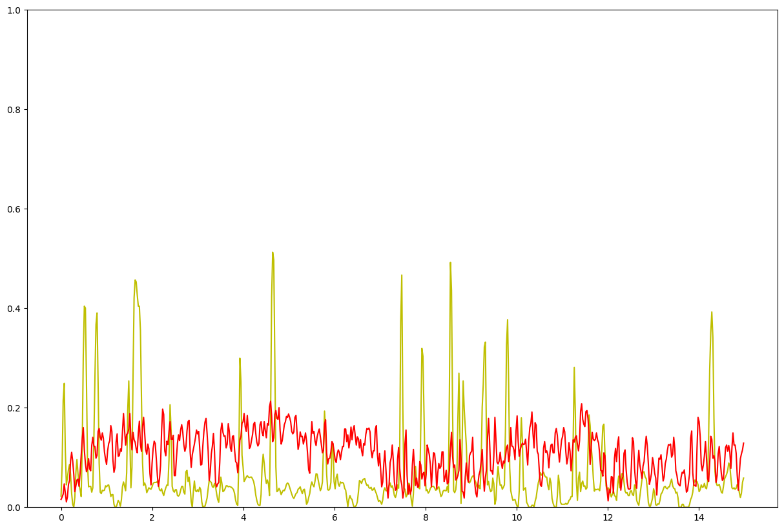
ZCR
Voice Noise
Yellow: voiced audio
Red: noise audio
Number of times a signal crosses the horizontal axis.
Recognises percussive from pitched sounds.
Indirectly related to pitch.
Notes:
Zero Crossing Rate is a time domain audio feature that gives us the number of times a signal crosses the horizontal axes.
It helps recognise percussive sounds (like sharp noises) from pitched sounds (steady tones).
Also, it’s indirectly related to pitch, the higher the ZCR the higher the pitch.
If we look at the graph, 2 audios are studied, the yellow is a voiced audio and the red is a noise audio
noise audio has higher ZCR than a voiced audio which is generally true because noise audios tends to have a more irregular waveform with rapid and unpredictable changes in amplitude.
NOTES
ZCR is a metric representing the number of times a signal crosses the horizontal axis. It helps recognise percussive from pitched sounds. Percussive sounds have random ZCR patterns and pitched sounds contain a more stable ZCR due to their periodic nature. ZCR is indirectly related to pitch, the higher the ZCR the higher the pitch. Also, if the audio is unvoiced (consonants or noise) it will contain a lower ZCR, while voiced audio (speech or singing) will obtain a higher ZCR due to the periodicity of vocal fold vibrations
Pitched Sounds: Smooth, steady tones (like a hum or a tuning fork).
Percussive Sounds: Abrupt, sharp noises (like clapping or a 'pop' sound).
Example with Music Genres:
Genre A: Bass-heavy Electronic Dance Music (EDM)
Characteristic: This genre typically features deep bass tones with a steady rhythm and low-pitched synthesizer sounds.
ZCR Expectation: The bass tones in EDM tracks usually have a relatively low ZCR because the waveform changes less frequently due to the sustained nature of the bass notes.
Pitch Interpretation: The low ZCR in EDM bass lines indirectly reflects their low pitch, as these sounds have longer periods of consistent waveform without rapid changes.
Genre B: Classical Flute Solo
Characteristic: Classical music often features instruments like flutes playing high-pitched melodies with intricate phrasing and rapid note changes.
ZCR Expectation: A classical flute solo will have a higher ZCR because the notes change more rapidly and the waveform oscillates more frequently.
Pitch Interpretation: The higher ZCR in the flute solo corresponds to its higher pitch, reflecting the rapid changes in the waveform due to the higher frequency notes played by the flute.
Relationship Between ZCR and Pitch:
Higher ZCR and Higher Pitch: Genres or instruments that produce higher-pitched sounds (like classical flute in Genre B) generally exhibit higher ZCR because of the faster oscillations and more frequent changes in the waveform.
Lower ZCR and Lower Pitch: Conversely, genres or instruments producing lower-pitched sounds (such as EDM bass in Genre A) tend to have lower ZCR because their waveforms change less frequently.

Slide 55
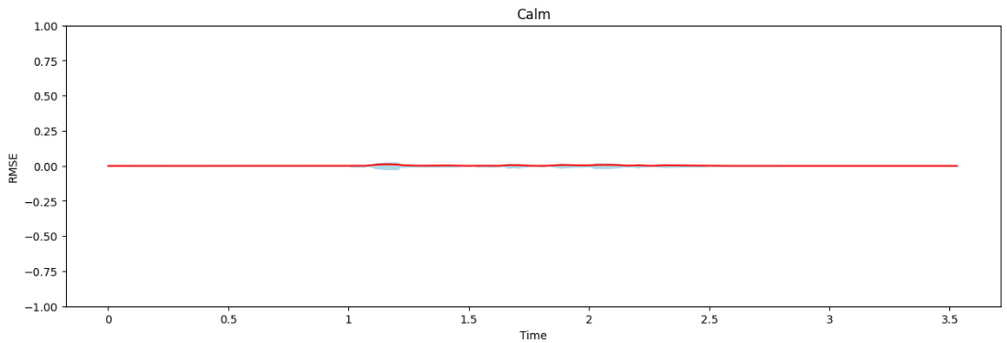
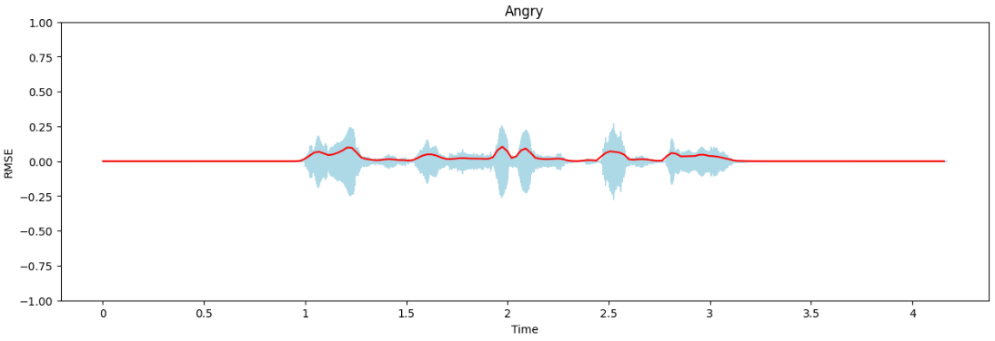
RMS
Calm Angry
Identify new segments or events.
Indicator of loudness.
Anger/Surprise → Higher RMS.
Sad/Calm → Lower RMS.
Notes:
Root Mean Square Energy is also a time domain feature which helps identify new segments.
It is the square root of the mean sum of energy for all samples in frame t.
It is also an indicator of loudness, the higher RMS, the louder the voice is.
for instance anger or surprise are usually loud audios so they represent higher rms and sad or calm represents lower rms
Also high RMS correlates with the audio being noisier or more complex.
If we see those 2 plots, the calm audio represent low rms and the angry audio represents higher rms
NOTES
Calm: 03-01-02-01-01-01-01.wav
Angry: 03-01-05-02-02-01-24.wav
Alt + 26 -> arrow
RMSE is a metric used in Audio segmentation to identify new segments or events. It is the square root of the mean sum of energy for all samples in frame t. It is also an indicator of loudness, obtaining higher RMSE values correlates with the audio signal containing more noise or being more complex
Importance of RMSE in Audio Segmentation:
Identifying New Segments or Events: RMSE is useful for detecting transitions in audio, such as the onset of new segments or events. Sharp changes in RMSE values can indicate the beginning or end of speech segments, which is crucial in segmenting continuous audio into meaningful parts.
Indicator of Loudness: Since RMSE measures the energy of the audio signal, higher RMSE values typically correspond to louder sounds. This can help distinguish between different types of speech events, such as a sudden shout or a soft whisper.
Role of RMSE in Speech Emotion Recognition (SER):
Emotion Detection:
Loudness and Emotion: Emotions can influence the loudness of speech. For example, anger or excitement may lead to higher RMSE values due to increased vocal intensity, while sadness or calmness may result in lower RMSE values. By analyzing RMSE, SER systems can gain insights into the emotional state of the speaker.
Noise and Complexity:
Noise Detection: High RMSE values may also indicate the presence of noise or more complex audio signals. In SER, it is essential to differentiate between actual emotional speech and background noise. RMSE can help in preprocessing steps to filter out noisy segments, ensuring that the emotion recognition algorithms work with cleaner audio data.

Slide 56
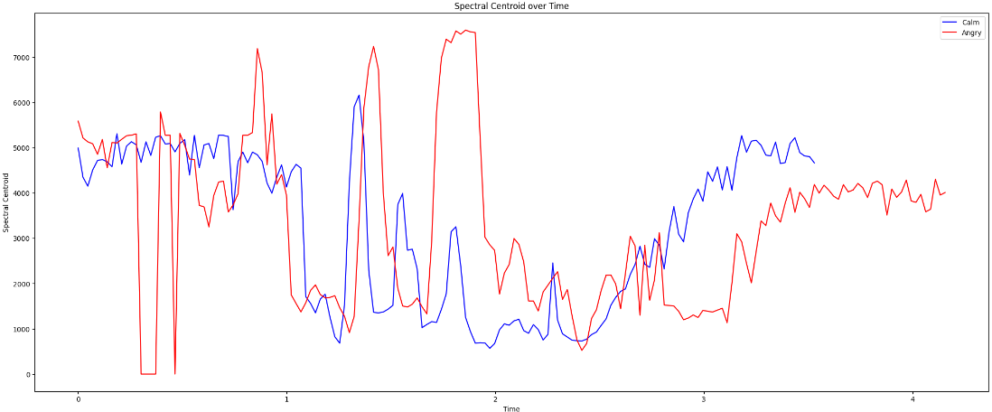
SC
Center of gravity of the magnitude spectrum.
Measures the "brightness" of a sound.
Anger/Surprise → Higher SC.
Sad/Calm → Lower SC.
Notes:
One of the key frequency-domain audio features is SC. It is presented as the center of gravity of the magnitude spectrum and indicates the frequency band where most of the energy is concentrated.
It also measures the "brightness" of a sound, how dull/sharp a sound is.
For example, angered speech often has a higher SC compared to calm speech due to increased high-frequency energy.
We can see from this graph, the red line (angry audio) has higher SC than the calm audio.
NOTES
One of the key frequency-domain audio features is SC. It is presented as the center of gravity of the magnitude spectrum and indicates the frequency band where most of the energy is concentrated. SC also measures the "brightness" of a sound, how dull/sharp a sound is. Let us take the changes in emotional state, it can affect the spectral properties of speech. For example, excited speech often has a higher SC compared to calm speech due to increased high-frequency energy
Detection of Emotional State:
Excited or Angry Speech: Typically has a higher SC due to increased high-frequency energy. Emotions such as excitement or anger often lead to more tension in the vocal cords, resulting in higher pitch and more high-frequency content.
Calm or Sad Speech: Typically has a lower SC due to dominance of low-frequency components. Emotions such as calmness or sadness often result in a more relaxed vocal tract, leading to lower pitch and more low-frequency energy.

Slide 57
Appendix D
ML Models

Slide 58
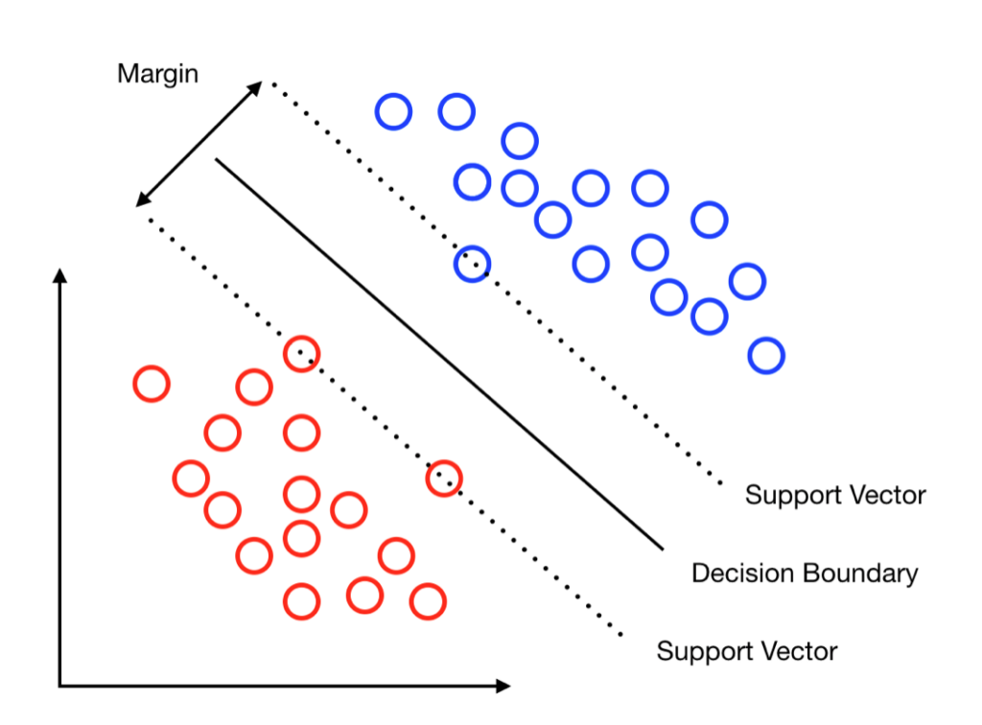
Support Vector Machine (SVM)
Hyperparameter :
Kernel: Specifies the kernel type
Linear
RBF
C : The inverse of regularization strength
0.01
0.1
1
10
Notes:
SVM, or Support Vector Machine, is a supervised learning algorithm that excels in classification tasks. It achieves this by finding an optimal hyperplane in a high-dimensional space that maximizes the margin between the data points belonging to different classes.
Hyper parameters :
Kernel: Specifies the kernel type
C: The inverse of regularization strength
imagine u have a group of friends some of them are good and the other are bad svn is like a sophisticated bouncer who can draw a clear line to separate the good guys from the bad guys ).

Slide 59
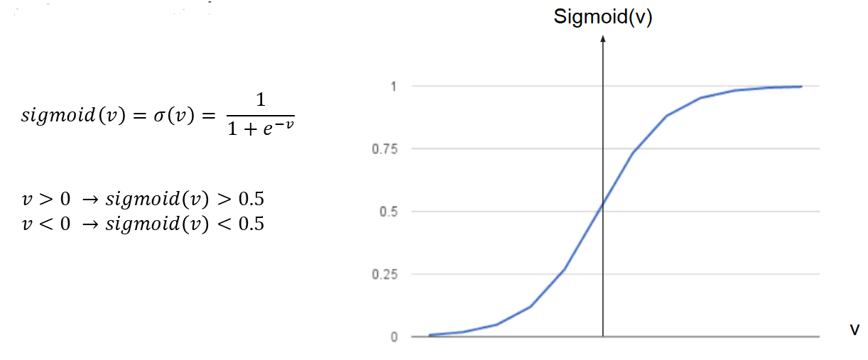
Logistic Regression (LR)
Hyperparameters:
C : inverse of regularization
0.01
0.1
1
Penalty :
Lasso Regression
Ridge Regression
Solver : optimization problem.
lbfgs
Max_iter : Maximum iterations
25
50
100
Notes:
It estimates the probability of an event occurring based on one or more independent variables.

Slide 60
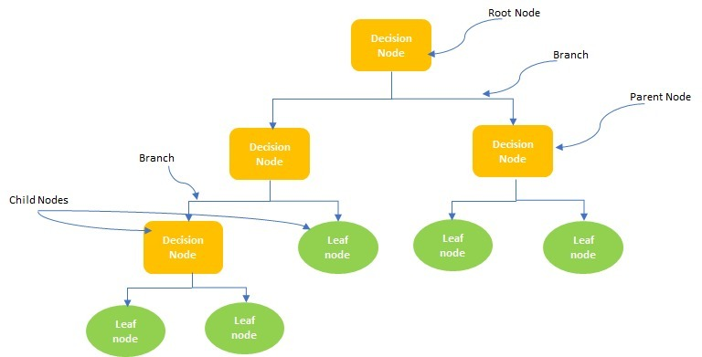
Decision Tree (DT)
Hyperparameters
Max_depth : maximum depth of the decision tree
3
5
7
Notes:
Imagine you're deciding whether to go for a picnic. A decision tree is like a flowchart that helps you navigate this choice.
for example if weather sunny / rainy —-> status cold or hot
DT is known of its :
Interpretability: Easy to understand
Flexibility: Can handle different data types
Robustness: Less sensitive to outliers

Slide 61
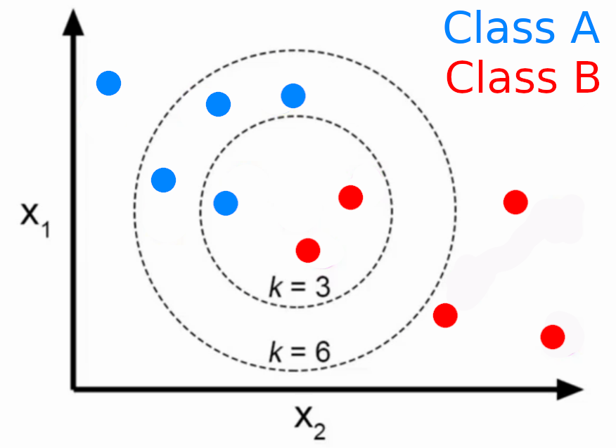
K-Nearest Neighbor (KNN)
Hyperparameters:
n_neighbors: The number of neighbors.
10
15
20
Notes:
It operates on the principle of similarity
KNN is like asking the closest group of people (your k neighbors) what their favorite music is and playing what the majority prefers.
Non-parametric: KNN doesn't make assumptions about the underlying data distribution, making it flexible for various datasets.
Lazy Learner: It stores the training data and performs all computations during prediction, hence the nickname "lazy learner."
Interpretability: KNN is relatively easy to understand and interpret, making it useful for applications where understanding the decision-making process is crucial.

Slide 62
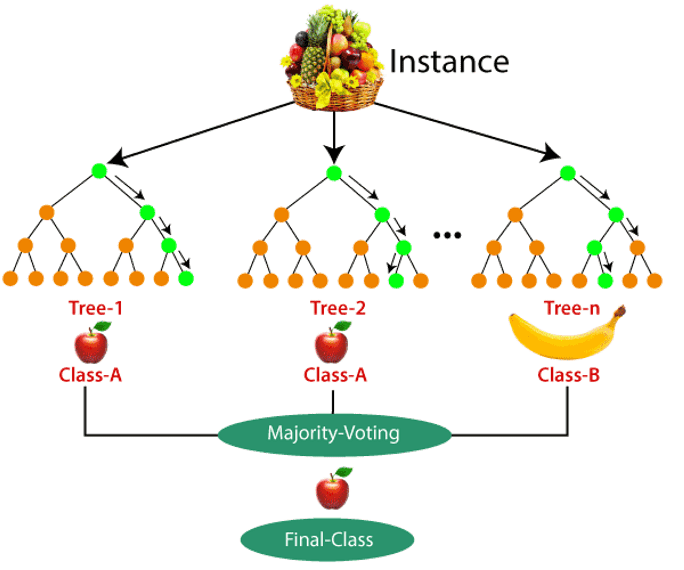
Random Forest (RF)
Hyperparameters :
n_estimators: the number of trees in the forest
30
50
100
Max_depth : maximum depth of the decision tree
5
10
25
Notes:
leverages the strengths of multiple decision trees to achieve high accuracy and robustness in both classification and regression tasks.
Imagine a forest instead of a single tree:
Ensemble Learning: Random forest is an ensemble learning method, meaning it combines the predictions of numerous decision trees (often hundreds or even thousands) to make a final prediction.
Diversity through Randomness:
Majority Vote (Classification):
a team of expert detectives trying to solve a complex case. each independently investigating the case with slightly different approaches, and then combining their best insights to reach a conclusion.

Slide 63
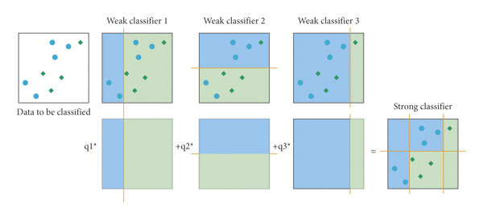
eXtreme Gradient Boosting (XGB)
Hyperparameters:
learning_rate: the step size shrinkage used to prevent overfitting.
0.01
0.1
1
n_estimators: the number of weak learners in the forest
100
200
500
Max_depth : maximum depth of the decision tree
3
10
Notes:
XGBoost: It utilizes a gradient boosting approach. which combines the predictions of multiple weak learners (often decision trees) to create a stronger final model
Here, the model iteratively builds an ensemble of weak learners (often decision trees) by focusing on the errors made by the previous models in the ensemble. This ensures each subsequent tree corrects the shortcomings of its predecessors.

Slide 64
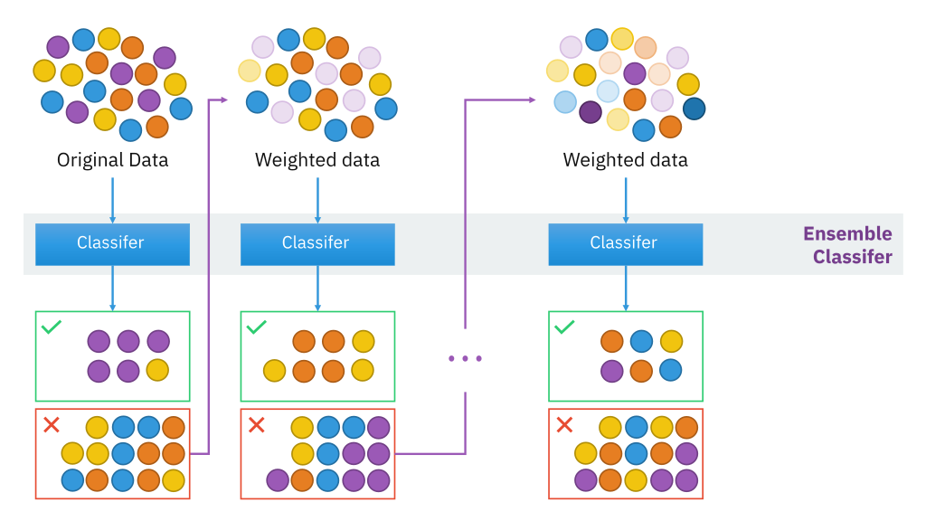
Adaptive-
Boosting (ADA)
Hyperparameters:
n_estimators: the number of weak learners in the forest
50
100
Learning_rate: contribution of each weak learner
0.01
0.1
1
Notes:
AdaBoost: It focuses on adaptively re-weighting data points during training. Initially, all data points have equal weight. As the model trains, weights are increased for data points that the current model struggles with, forcing the next model in the ensemble to focus on those points.

Slide 65
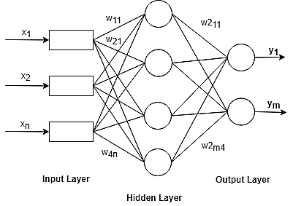
Multi-Layer-Perceptron (MLP)
Hyperparameters:
hidden_layer_sizes: represents the number of neurons in the hidden layer.
50, 100 and 200
activation: the activation function
Relu and tanh
solver: the solver for weight optimization.
adam
alpha: the strength of the L2 regularization
0.001, 0.01, 0.1, and 1
Notes:
It's a type of artificial neural network with multiple layers that learns complex patterns from data. Think of it as a brain-inspired system that gets better at tasks like image recognition or speech recognition the more data it sees.

Slide 66
Appendix E
DL Models

Slide 67
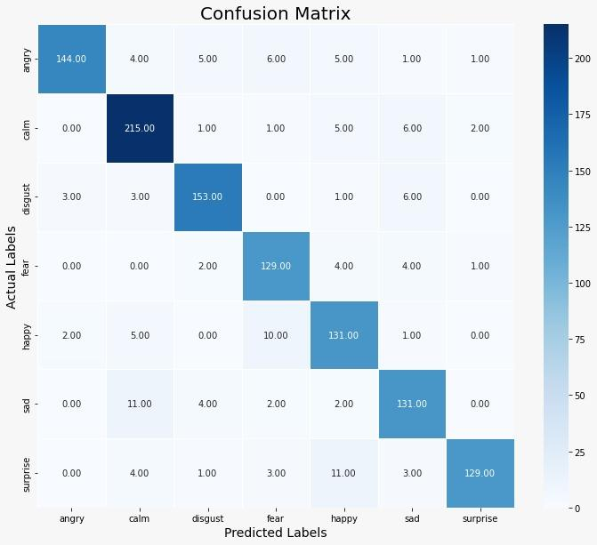

Approach 2 - DL Model 1 - 2
Notes:
This is the confusion matrix of the actual and predicted emotions for Model 3, and their metrics.
Neutral got the best prediction with an F1-Score of 97% and Recall of 100% which signifies that all the actual neutral classes were correctly classified.
It is followed by Surprise, Disgust, and Angry with a 96% F1-Score. The worst performer is Happy with an F1-Score of 92%, by having 9 falsely classified out of 149
NOTES
For the last proposed model (Model 3), as before the confusion matrix of the actual and predicted emotions is shown in Figure 5.6, and their metrics are detailed in Table 5.3. Model 3 outperformed all the other proposed models with an accuracy of 95.31% on the test data. Neutral got the best prediction with an F1-Score of 97% and Recall of 100% which signifies that all the actual neutral classes were correctly classified. It is followed by Surprise, Disgust, and Angry with a 96% F1-Score. The worst performer is Happy with an F1-Score of 92%, by having 9 falsely classified out of 149

Slide 68
Approach 2 - DL Model
Feature Block (FB) | Layer (Type)
FB1 | Conv1D (512 filters, kernel_size=5, strides=1, padding='same', activation='relu') BatchNormalization MaxPooling1D (pool_size=5, strides=2, padding='same')
FB2 | Conv1D (512 filters, kernel_size=5, strides=1, padding='same', activation='relu') BatchNormalization MaxPooling1D (pool_size=5, strides=2, padding='same') Dropout (0.2)
FB3 | Conv1D (256 filters, kernel_size=5, strides=1, padding='same', activation='relu') BatchNormalization MaxPooling1D (pool_size=5, strides=2, padding='same')
FB4 | Conv1D (256 filters, kernel_size=3, strides=1, padding='same', activation='relu') BatchNormalization MaxPooling1D (pool_size=5, strides=2, padding='same') Dropout (0.2)
FB5 | Conv1D (128 filters, kernel_size=3, strides=1, padding='same', activation='relu') BatchNormalization MaxPooling1D (pool_size=3, strides=2, padding='same') Dropout (0.2)
Notes:
The following CNN architecture conducted contains five FB layers, each FB has a 1D Convolution with the "Rectified Linear Unit (ReLU)" activation function, "same" padding, 1D Max-Pooling with stride equal to two and "same" padding, and a dropout layer with a dropout rate of 0.2. The first three FBs contain for the 1D convolution a Kernel Size of five, and for the 1D Max-Pooling a pooling size of five. As for the fourth Kernel Size, it will be changed to three, and the final FB will have a Kernel Size of five for the 1D convolution and a pool size of 3 for the 1D Max-Pooling. This output will go through an FC layer with "ReLU" activation, following a Batch Normalization, which will finally go through FC with "softmax" activation and 7 units output. The model was trained using the training x and y(target) variables for 40 epochs. During training, the validation data was used. Each batch during training consisted of 64 samples, and callbacks including the ones mentioned were employed

Slide 69
Approach 2 - DL Model
Layer (Type)
Flatten
Dense (512 units, activation='relu') BatchNormalization
Dense (7 units, activation='softmax')
Model Compilation:
Optimizer: adam
Loss: categorical_crossentropy
Metrics: accuracy
Notes:
The following CNN architecture conducted contains five FB layers, each FB has a 1D Convolution with the "Rectified Linear Unit (ReLU)" activation function which will be defined in Section 4.2.9, "same" padding, 1D Max-Pooling with stride equal to two and "same" padding, and a dropout layer with a dropout rate of 0.2. The first three FBs contain for the 1D convolution a Kernel Size of five, and for the 1D Max-Pooling a pooling size of five. As for the fourth Kernel Size, it will be changed to three, and the final FB will have a Kernel Size of five for the 1D convolution and a pool size of 3 for the 1D Max-Pooling. This output will go through an FC layer with "ReLU" activation, following a Batch Normalization, which will finally go through FC with "softmax" activation and 7 units output. The model was trained using the training x and y(target) variables for 40 epochs. During training, the validation data was used. Each batch during training consisted of 64 samples, and callbacks including the ones mentioned were employed
**Model Compilation**:
- **Optimizer**: `adam`
- **Loss**: `categorical_crossentropy`
- **Metrics**: `accuracy`
NOTES
Categorical cross-entropy is a specific type of loss function commonly used in machine learning tasks where the output (prediction) is a categorical probability distribution over multiple classes. Here’s a detailed explanation:
1. **Definition**: Categorical cross-entropy is used when dealing with multi-class classification problems, where each sample belongs to one of several classes. It measures the dissimilarity between the true distribution (the actual labels) and the predicted probability distribution output by the model.
2. **Usage**: Suppose you have a classification problem with \( K \) classes. For each sample, the model predicts a probability distribution \( \hat{y} = (\hat{y}_1, \hat{y}_2, ..., \hat{y}_K) \), where \( \hat{y}_i \) is the predicted probability that the sample belongs to class \( i \). The true label \( y = (y_1, y_2, ..., y_K) \) is a one-hot encoded vector (or categorical labels) indicating the correct class.
3. **Mathematical Formulation**: The categorical cross-entropy \( H(y, \hat{y}) \) is calculated as:
\[
H(y, \hat{y}) = - \sum_{i=1}^{K} y_i \log(\hat{y}_i)
\]
Here, \( y_i \) is the true probability distribution (which is 0 except for the true class label which is 1), and \( \hat{y}_i \) is the predicted probability for class \( i \).
4. **Objective**: The goal during training is to minimize the categorical cross-entropy loss function. This means adjusting the model parameters (weights and biases) so that the predicted probability distribution \( \hat{y} \) becomes as close as possible to the true distribution \( y \).
5. **Properties**: Categorical cross-entropy penalizes incorrect predictions heavily, especially when the predicted probability diverges significantly from the true probability. It encourages the model to produce high probabilities for the correct classes and low probabilities for incorrect classes.
In summary, categorical cross-entropy is a fundamental loss function in multi-class classification tasks, crucial for training models to accurately predict the probabilities of multiple classes.
Certainly! The Adam optimizer adjusts the learning rates of each parameter individually based on estimates of the first and second moments of the gradients. Here is the mathematical formulation of the Adam optimizer:
### Initialization:
Adam initializes two moving average parameters:
- \( m \): Exponentially decaying average of past gradients.
- \( v \): Exponentially decaying average of past squared gradients.
Both are initialized to zero vectors of the same length as the parameters \( \theta \) of the model.
### Algorithm Steps:
1. **Compute Gradients**: Compute gradients \( g_t \) of the objective function \( J(\theta) \) with respect to the parameters \( \theta \).
2. **Update Bias-Corrected First Moment Estimate**:
\[
m_t = \beta_1 m_{t-1} + (1 - \beta_1) g_t
\]
Here, \( \beta_1 \) (typically 0.9) controls the decay rate of the first moment estimate \( m \).
3. **Update Bias-Corrected Second Moment Estimate**:
\[
v_t = \beta_2 v_{t-1} + (1 - \beta_2) g_t^2
\]
Here, \( \beta_2 \) (typically 0.999) controls the decay rate of the second moment estimate \( v \).
4. **Compute Bias-Corrected Estimates**:
\[
\hat{m}_t = \frac{m_t}{1 - \beta_1^t}
\]
\[
\hat{v}_t = \frac{v_t}{1 - \beta_2^t}
\]
These steps correct bias in the first and second moment estimates.
5. **Update Parameters**:
\[
\theta_{t+1} = \theta_t - \frac{\eta}{\sqrt{\hat{v}_t} + \epsilon} \hat{m}_t
\]
Here,
- \( \eta \) is the learning rate.
- \( \epsilon \) is a small constant (e.g., \( 10^{-8} \)) to prevent division by zero.
### Summary:
Adam adapts the learning rate for each parameter based on the estimates of the first moment (the mean) and the second moment (the uncentered variance) of the gradients. It combines the advantages of both momentum-based methods (like RMSProp) and gradient averaging methods (like AdaGrad), making it robust and efficient for training deep learning models.
This algorithm effectively balances between momentum (which helps to keep the updates smooth and consistent) and adaptive learning rates (which adjust individually for each parameter based on their gradients' characteristics).
Batch normalization is a technique used in neural networks to improve the training speed, stability, and performance of artificial neural networks. It normalizes the inputs of each layer in a mini-batch (hence the name "batch" normalization) by adjusting and scaling the activations.
### Key Objectives of Batch Normalization:
1. **Accelerating Training**:
- By normalizing the inputs to each layer, batch normalization reduces the internal covariate shift. This allows the network to converge faster during training, as it helps in maintaining a stable distribution of inputs throughout the network.
2. **Improving Gradient Flow**:
- Normalization helps in mitigating the vanishing or exploding gradient problems, which can occur in deep networks during backpropagation. This is because the normalized inputs have a more consistent range of values, making it easier for the gradients to propagate backward through the network.
3. **Regularizing the Model**:
- Batch normalization acts as a form of regularization by adding noise to each layer during training. This noise can be seen as a kind of regularization, similar to dropout, which helps to prevent overfitting and improve the generalization of the model.
### How Batch Normalization Works:
1. **Normalization Step**:
- For each mini-batch during training, batch normalization normalizes the activations of each layer by subtracting the mini-batch mean and dividing by the mini-batch standard deviation.
2. **Scaling and Shifting**:
- After normalization, the normalized activations are scaled by a learnable parameter (gamma) and shifted by another learnable parameter (beta). This allows the network to learn the optimal scale and shift for each layer's inputs.
3. **During Inference**:
- During inference (i.e., when making predictions on new data), batch normalization uses the accumulated statistics (mean and variance) from the entire training dataset rather than from mini-batches. This ensures consistent behavior across different batches of data.
### Benefits of Batch Normalization:
- **Stable Training**: Helps in stabilizing the learning process and speeds up convergence.
- **Improved Gradient Flow**: Mitigates gradient vanishing/exploding problems.
- **Regularization**: Acts as a form of regularization, reducing overfitting.
- **Efficient Training**: Enables the use of higher learning rates, potentially reducing the overall training time.
In summary, batch normalization is a powerful technique that significantly enhances the training of deep neural networks by normalizing and regulating the inputs to each layer, thereby improving performance and stability during both training and inference.

Slide 70
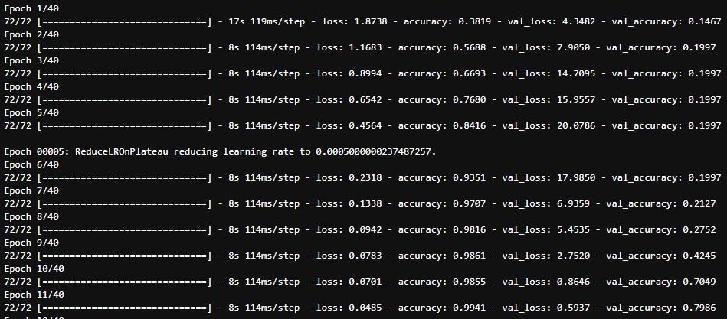
Epoch 40/40
72/72 [==============================] - 8s 114ms/step - loss: 0.0027 - accuracy: 1.0000 - val_loss: 0.1578 - val_accuracy: 0.9531
Notes:
The learning rate is a critical hyperparameter in machine learning and deep learning models, influencing how quickly or slowly a model learns from data during training. Here are some key points on its importance:
1. **Convergence Speed**: The learning rate determines the speed at which a model converges to the minimum of the loss function. A high learning rate can speed up the training process but may overshoot the optimal solution. A low learning rate ensures gradual convergence but can make the training process very slow.
2. **Stability**: A properly set learning rate helps maintain the stability of the training process. If the learning rate is too high, the training process can become unstable, causing the loss function to oscillate or even diverge. If it is too low, the training might get stuck in local minima or plateaus, preventing the model from finding the global minimum.
3. **Accuracy**: The learning rate affects the final accuracy of the model. An appropriate learning rate can help the model achieve better accuracy by finding the optimal weights that minimize the loss function. In contrast, an inappropriate learning rate can prevent the model from reaching its best performance.
4. **Efficiency**: Efficient training involves balancing the speed of convergence and the quality of the solution. A good learning rate helps in efficiently utilizing computational resources by avoiding unnecessary epochs or iterations.
5. **Adaptive Learning Rates**: Techniques like learning rate schedules and adaptive learning rate methods (e.g., Adam, RMSprop) adjust the learning rate during training, starting with a higher learning rate for faster convergence and gradually decreasing it to fine-tune the model.
6. **Generalization**: The learning rate also affects the generalization ability of the model. A well-chosen learning rate can help in achieving a good balance between underfitting and overfitting, thereby improving the model's performance on unseen data.
In summary, the learning rate is a crucial parameter that significantly impacts the effectiveness, efficiency, and stability of the training process in machine learning and deep learning models.

Slide 71
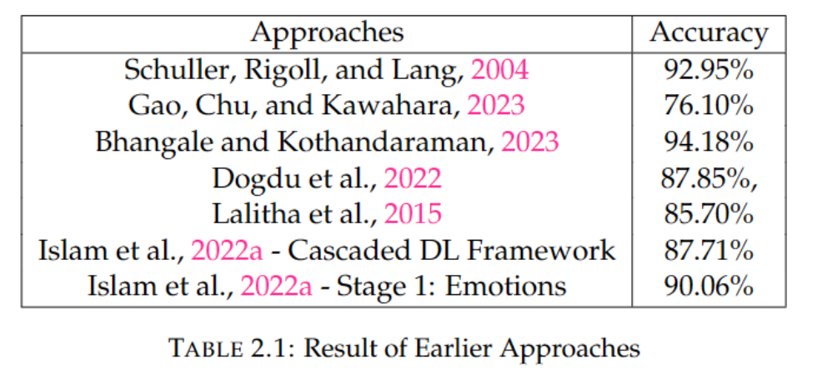

Slide 72
